Slide 1
lINEAR algebra ch4 VECTOR SPACES AND SUB SPACES
Mirjam Nilsson

Slide 2
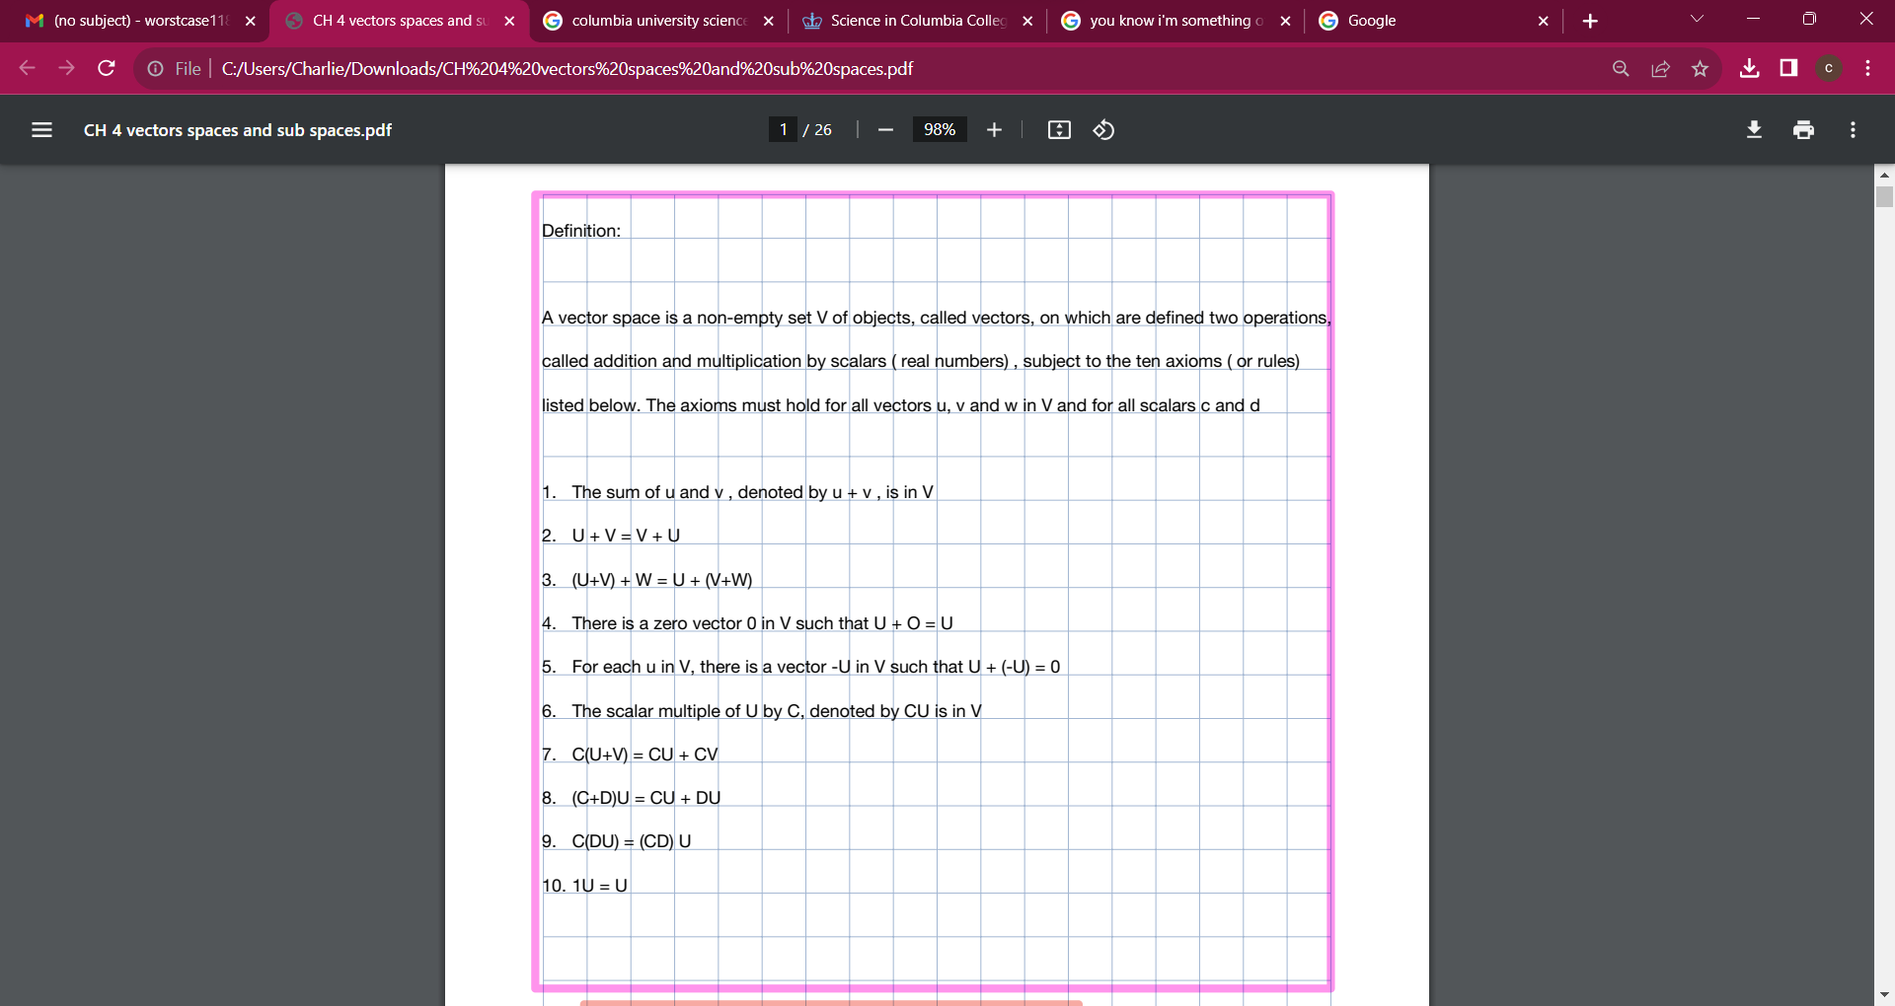
AGENDA
Introduction
Primary goals
Areas of growth
Timeline
Summary

Slide 3
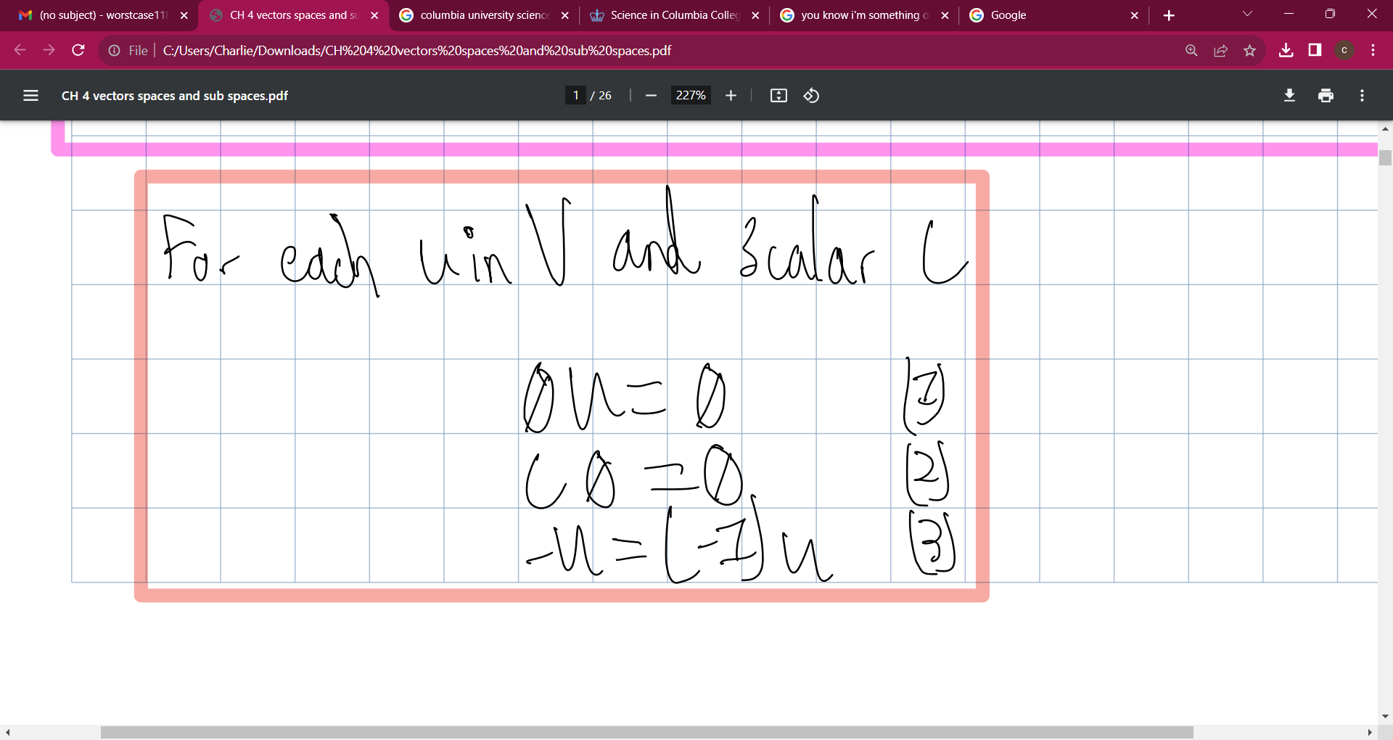
INTRODUCTION
At Contoso, we empower organizations to foster collaborative thinking to further drive workplace innovation. By closing the loop and leveraging agile frameworks, we help business grow organically and foster a consumer-first mindset.​

Slide 4
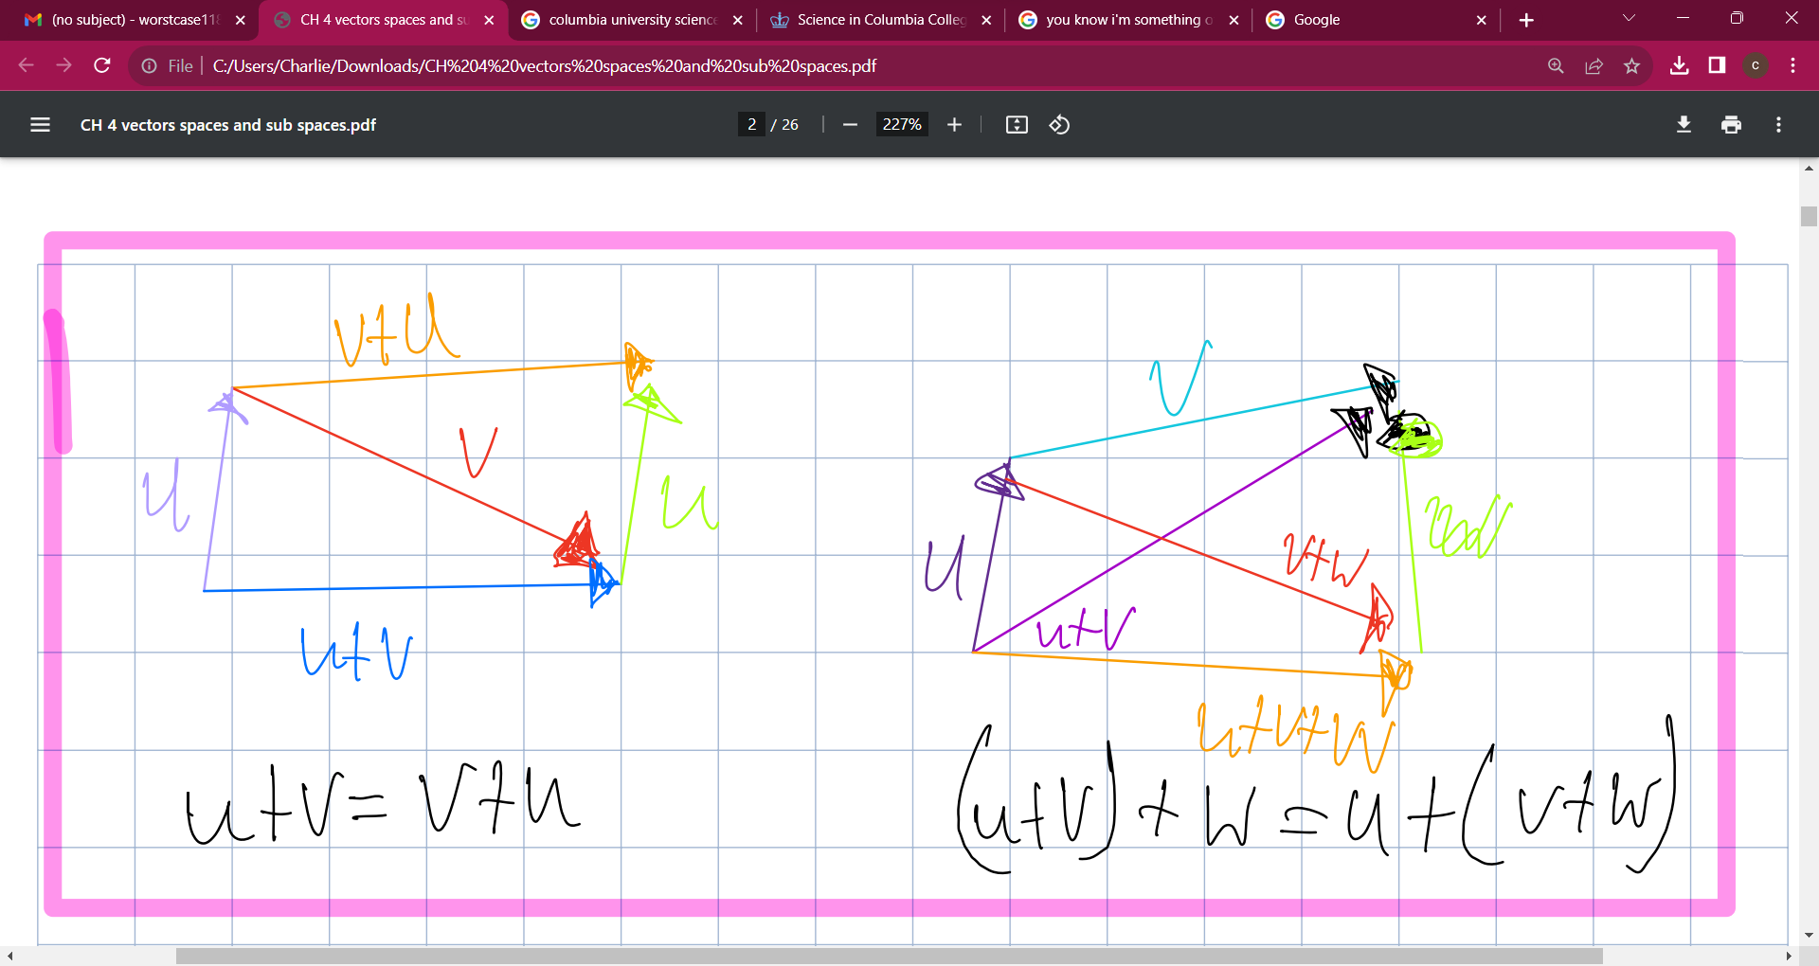
PRIMARY GOALS
Annual revenue growth

Slide 5
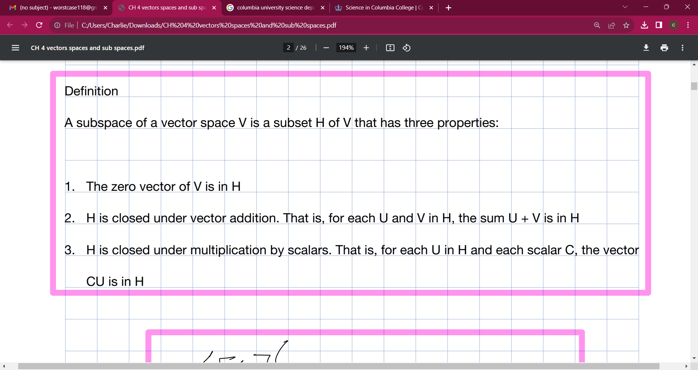
AREAS OF GROWTH
​ | CATEGORY 1 | CATEGORY 2 | CATEGORY 3​ | CATEGORY 4​
Q1 | 4.5​ | 2.3​ | 1.7​ | 5​.0
Q2 | 3.2​ | 5.1​ | 4.4​ | 3​.0
Q3 | 2.1​ | 1.7​ | 2.5​ | 2.8​
Q4 | 4.5​ | 2.2​ | 1.7​ | 7.0

Slide 6
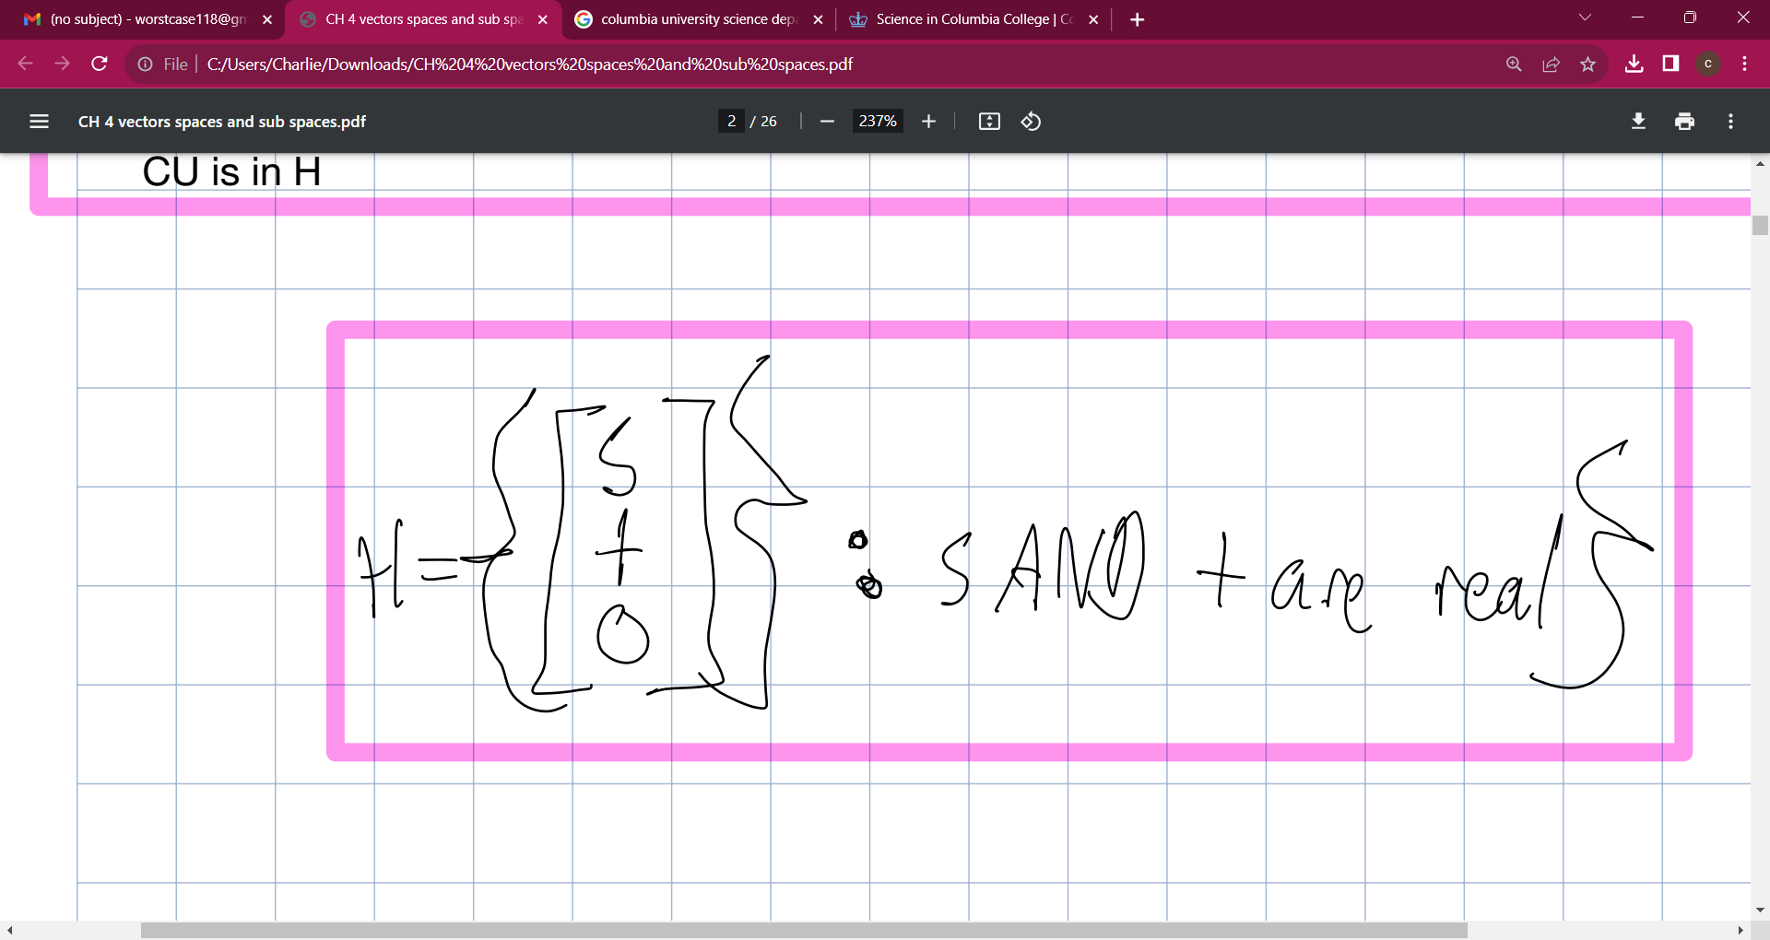
BUSINESS OPPORTUNITIES ARE LIKE BUSES. THERE'S ALWAYS ANOTHER ONE COMING.​
Richard Branson

Slide 7
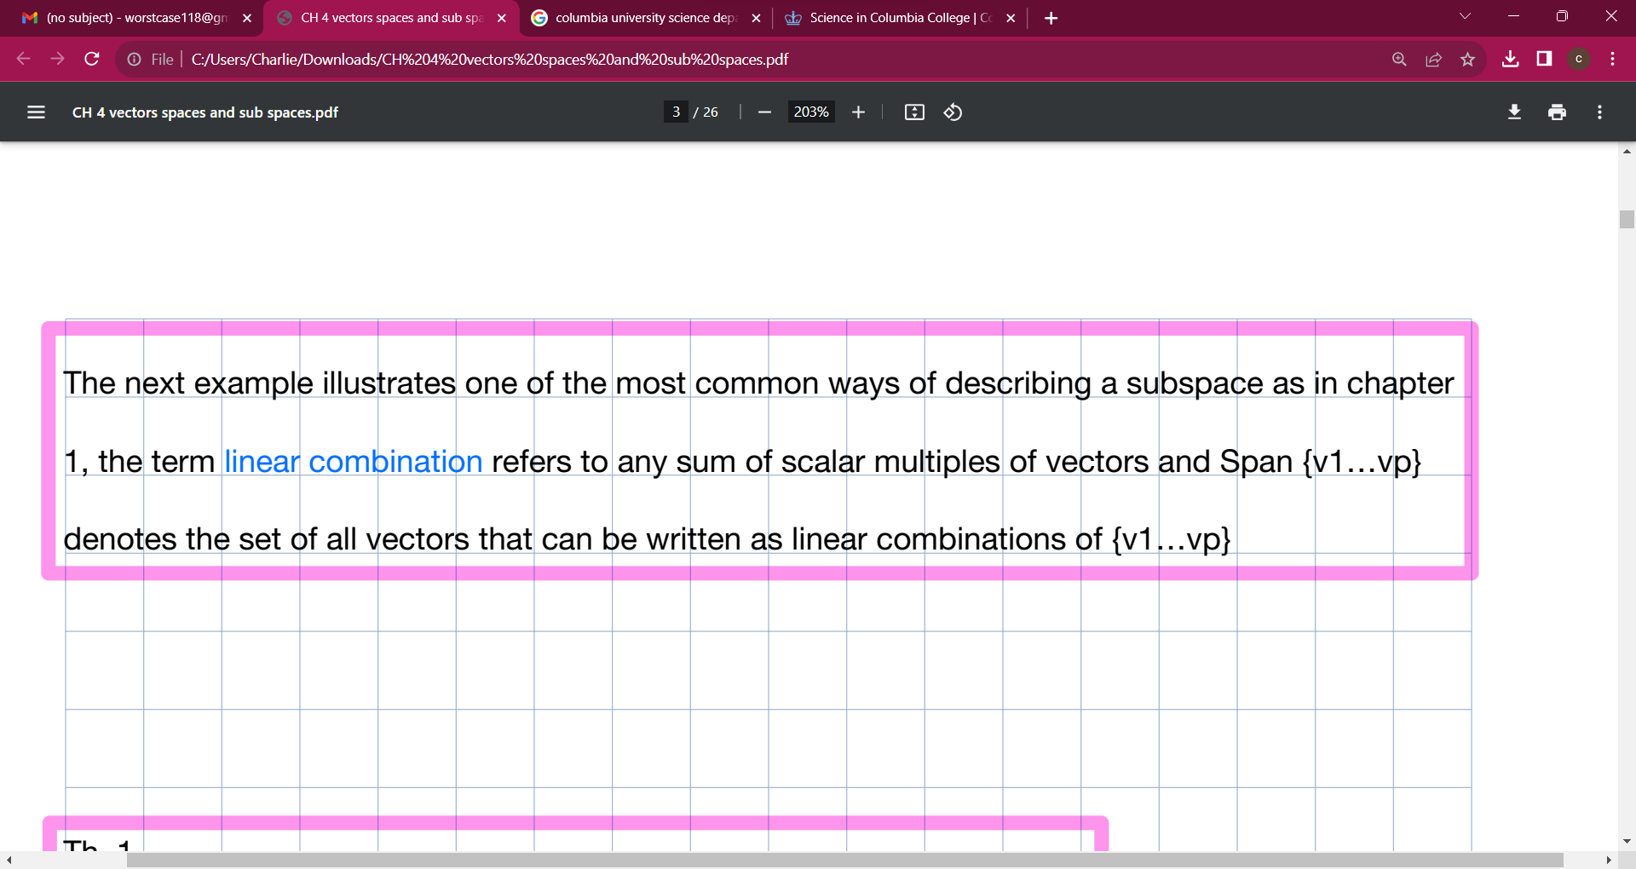




MEET OUR TEAM
TAKUMA HAYASHI
MIRJAM NILSSON
FLORA BERGGREN
RAJESH SANTOSHI
President
Chief Executive Officer
Chief Operations Officer
VP Marketing

Slide 8
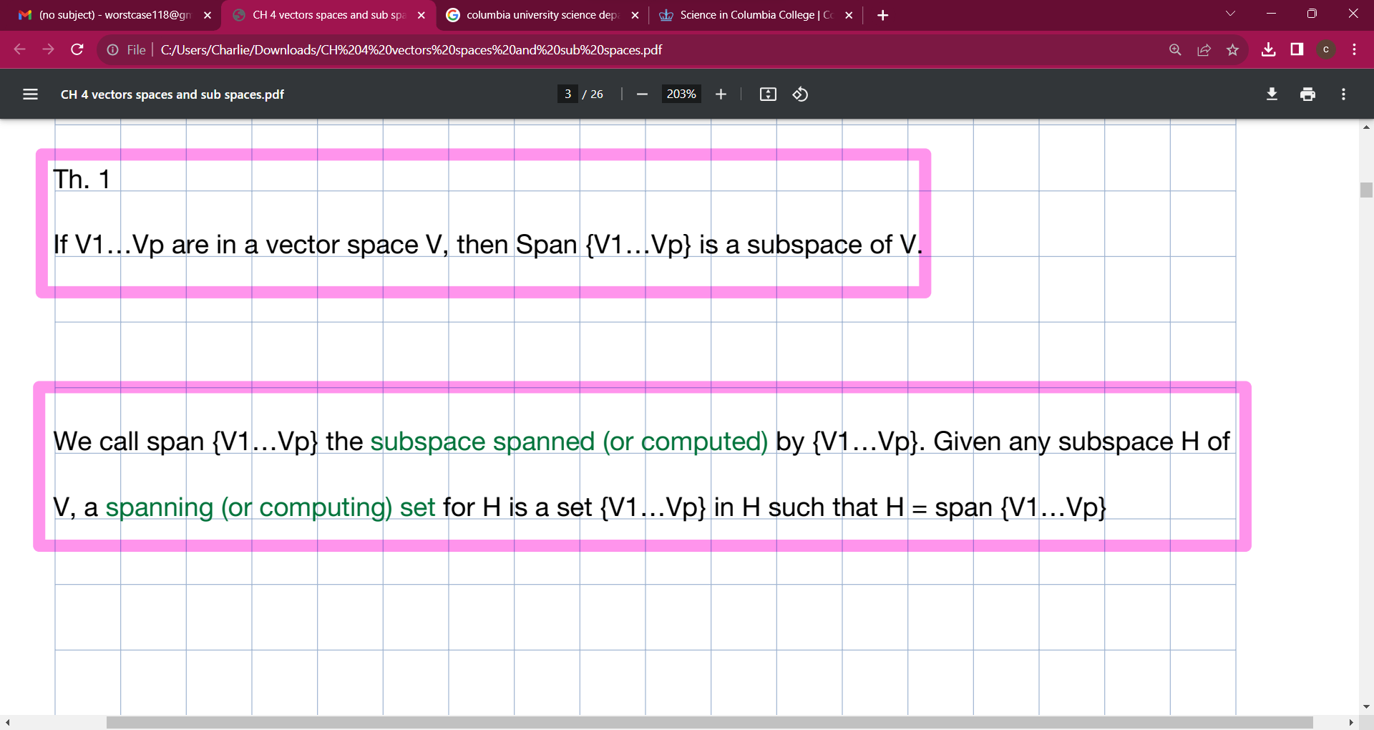







MEET OUR TEAM
TAKUMA HAYASHI
MIRJAM NILSSON
RAJESH SANTOSHI
RAJESH SANTOSHI
President
Chief Executive Officer
Chief Operations Officer
VP Marketing
GRAHAM BARNES
ROWAN MURPHY
ELIZABETH MOORE
ROBIN KLINE
VP Product
SEO Strategist
Product Designer
Content Developer

Slide 9
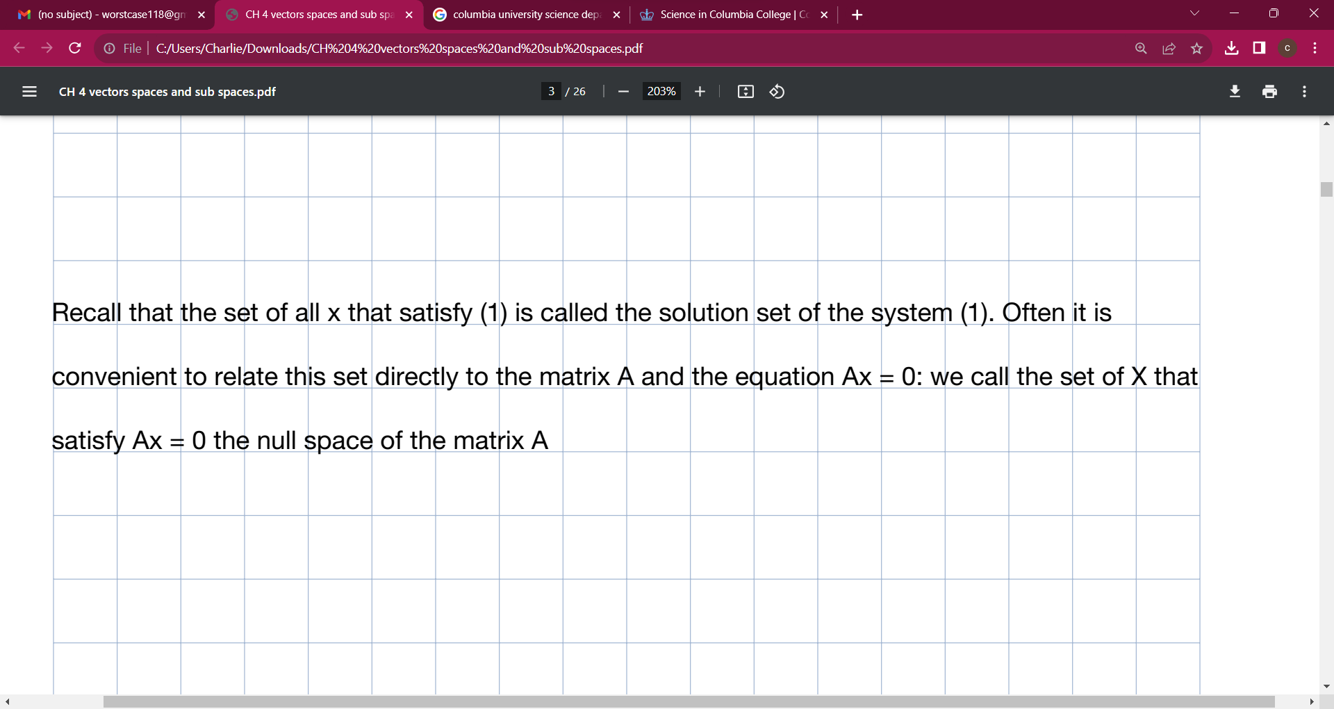
PLAN FOR PRODUCT LAUNCH
Deploy strategic networks with compelling e-business needs
PLANNING
Synergize scalable e-commerce
MARKETING
Disseminate standardized metrics
DESIGN
Coordinate e-business applications
Foster holistically superior methodologies
LAUNCH
STRATEGY

Slide 10


Slide 11
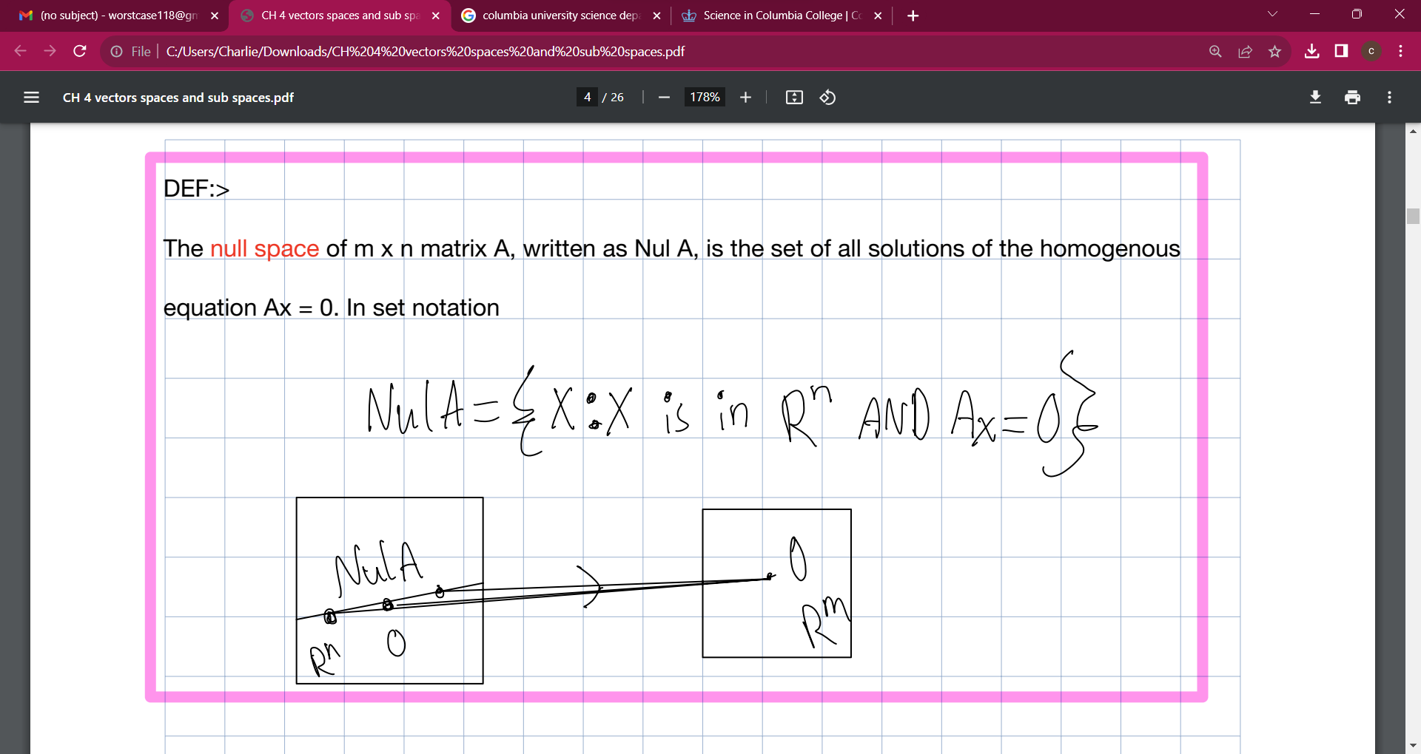
TIMELINE
Q1
Synergize scalable e-commerce
Q2
Coordinate e-business applications
Q3
Deploy strategic networks with compelling e-business needs
Q4
Disseminate standardized metrics

Slide 12
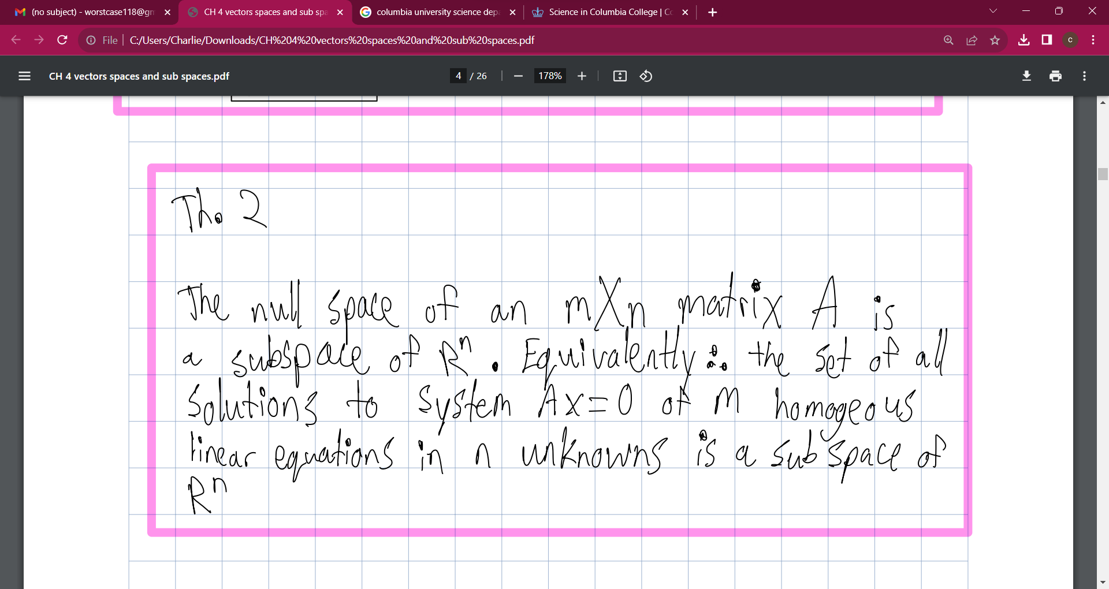
AREAS OF FOCUS
B2B MARKET SCENARIOS
CLOUD-BASED OPPORTUNITIES
Develop winning strategies to keep ahead of the competition
​Capitalize on low-hanging fruit to identify a ballpark value
​Visualize customer directed convergence​
Iterative approaches to corporate strategy
​Establish a management framework from the inside​

Slide 13
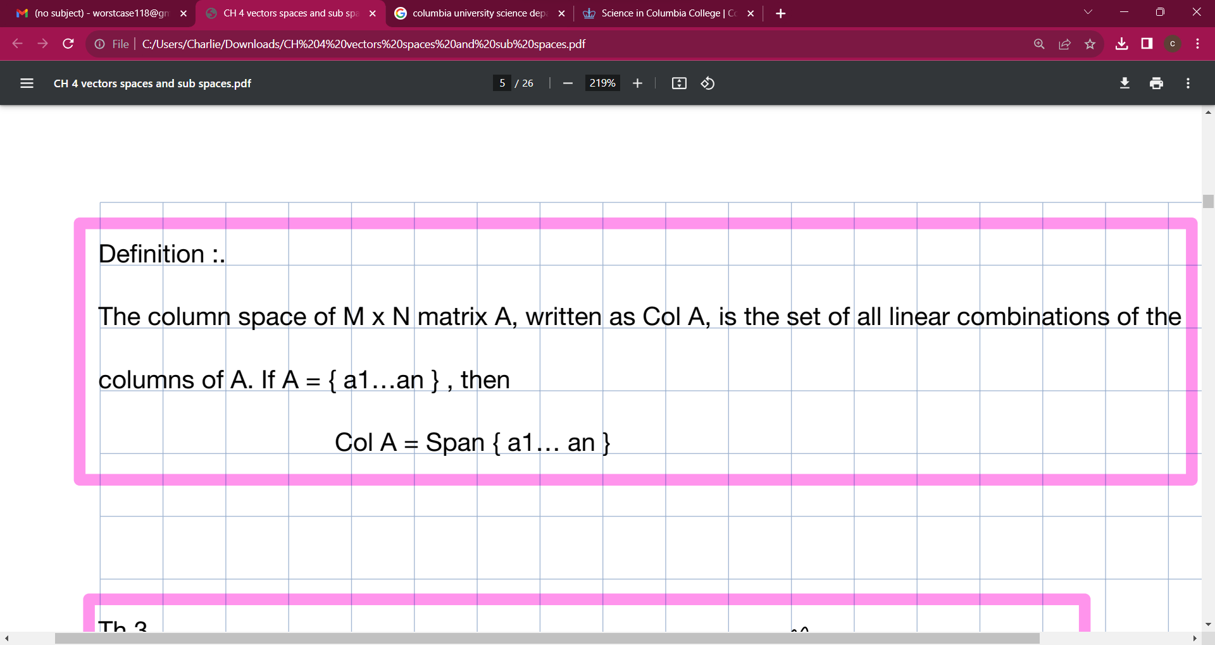
HOW WE GET THERE
ROI
NICHE MARKETS
SUPPLY CHAINS
Envision multimedia-based expertise and cross-media growth strategies​
​Engage worldwide methodologies with web-enabled technologies​
Pursue scalable customer service through sustainable strategies​
Engage top-line web services with cutting-edge deliverables​​​
Cultivate one-to-one customer service with robust ideas​
Maximize timely deliverables for real-time schemas​

Slide 14
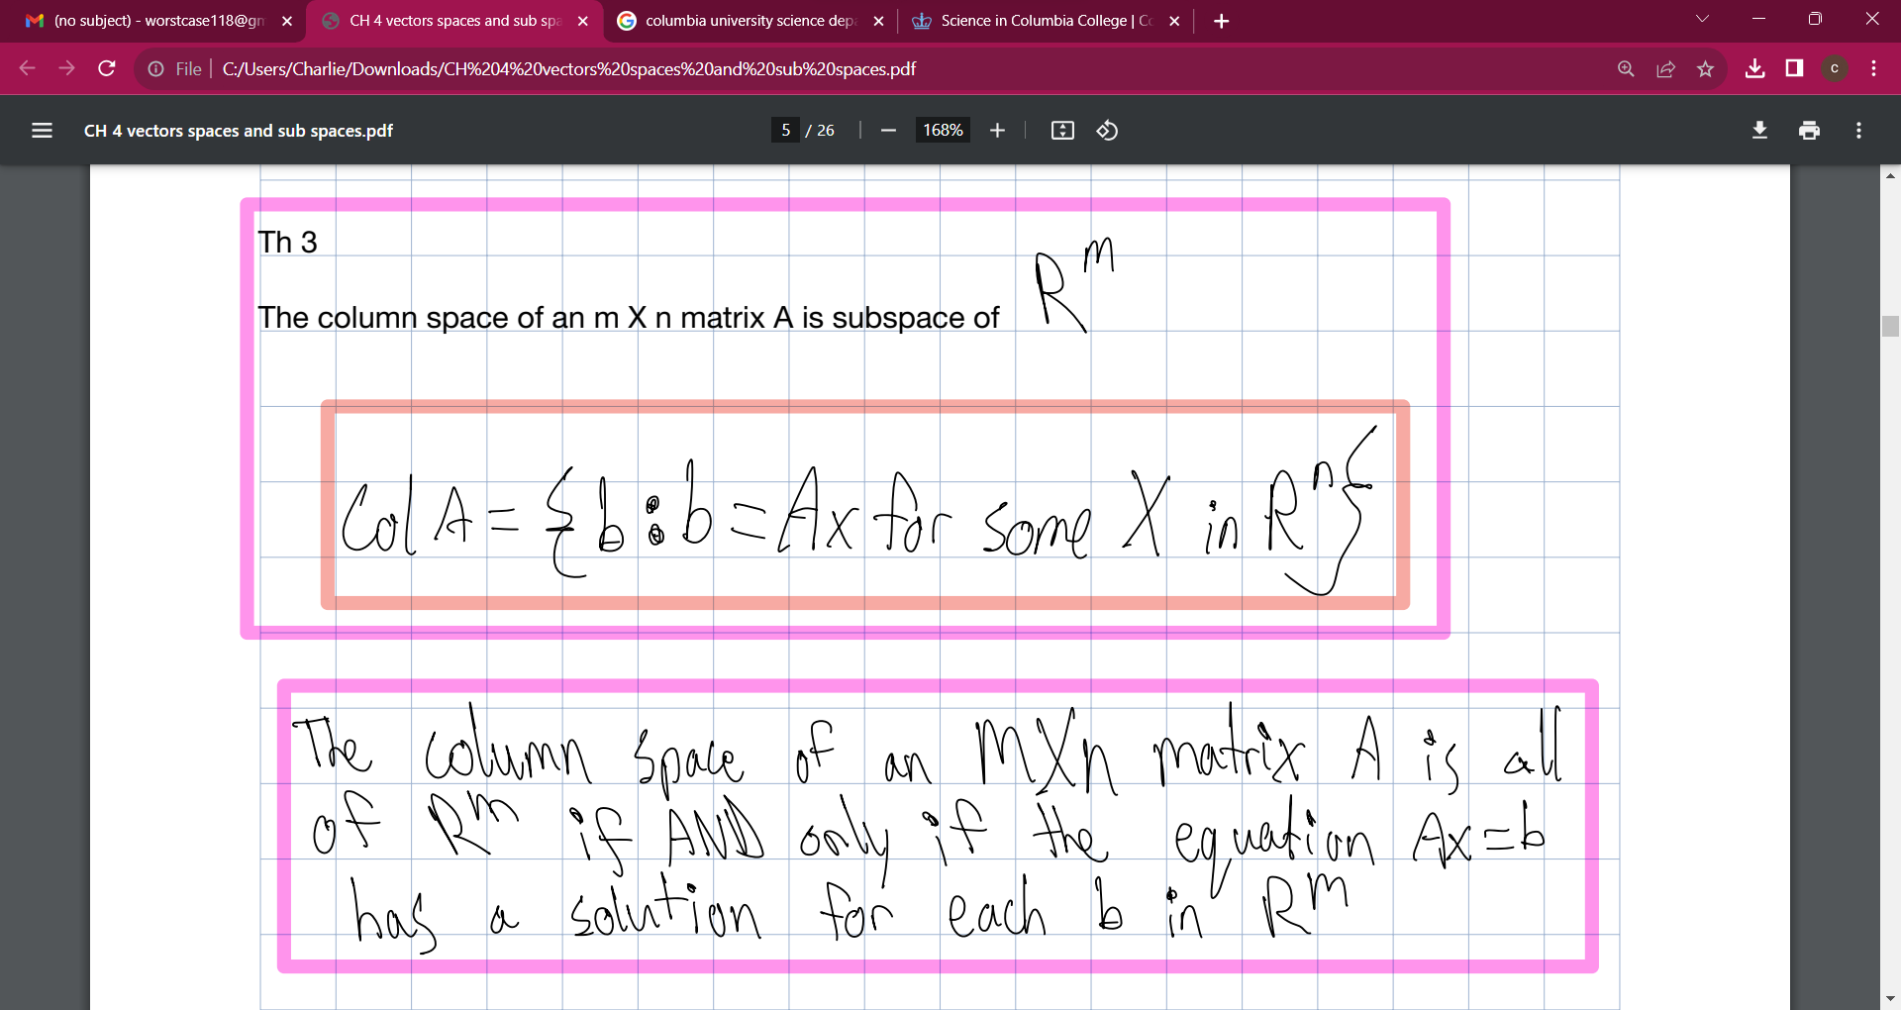
SUMMARY
At Contoso, we believe in giving 110%. By using our next-generation data architecture, we help organizations virtually manage agile workflows. We thrive because of our market knowledge and great team behind our product. As our CEO says, "Efficiencies will come from proactively transforming how we do business."​

Slide 15
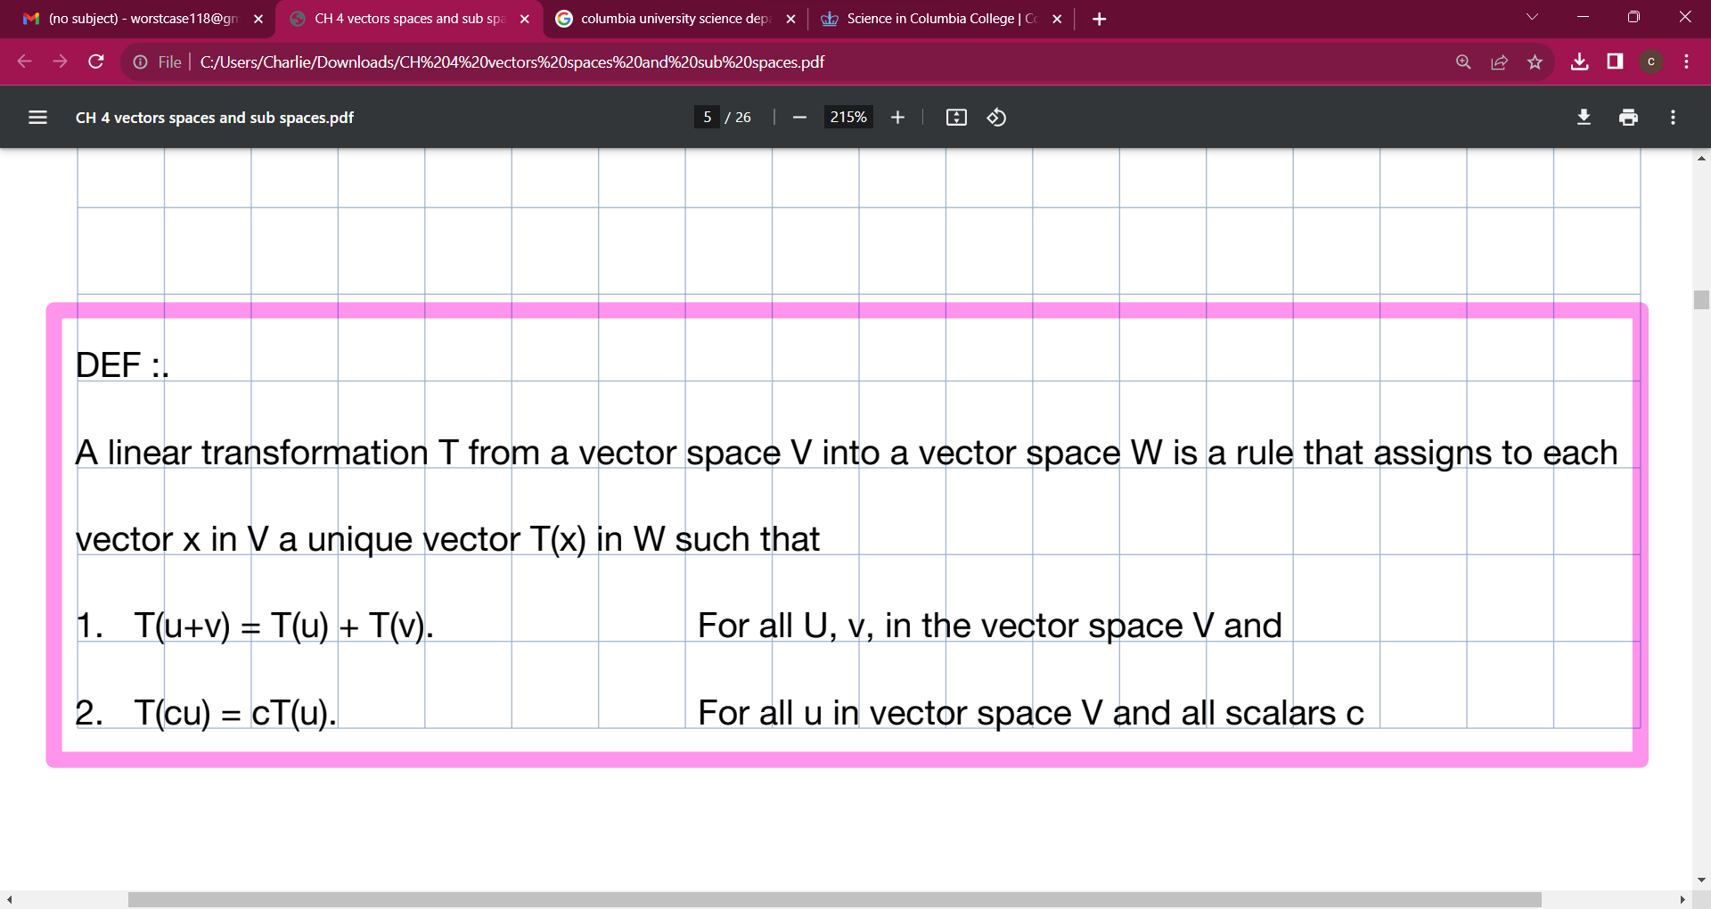
THANK YOU
Mirjam Nilsson
mirjam@contoso.com
www.contoso.com

Slide 16
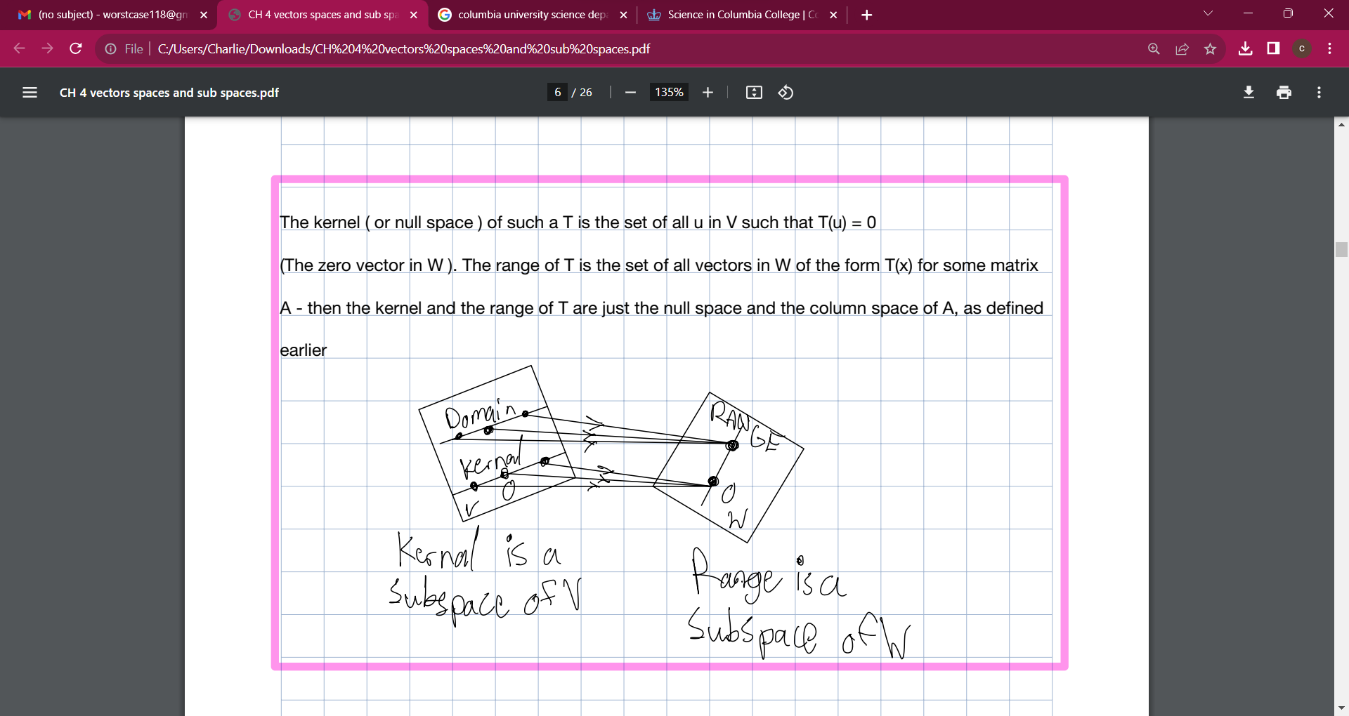

Slide 17
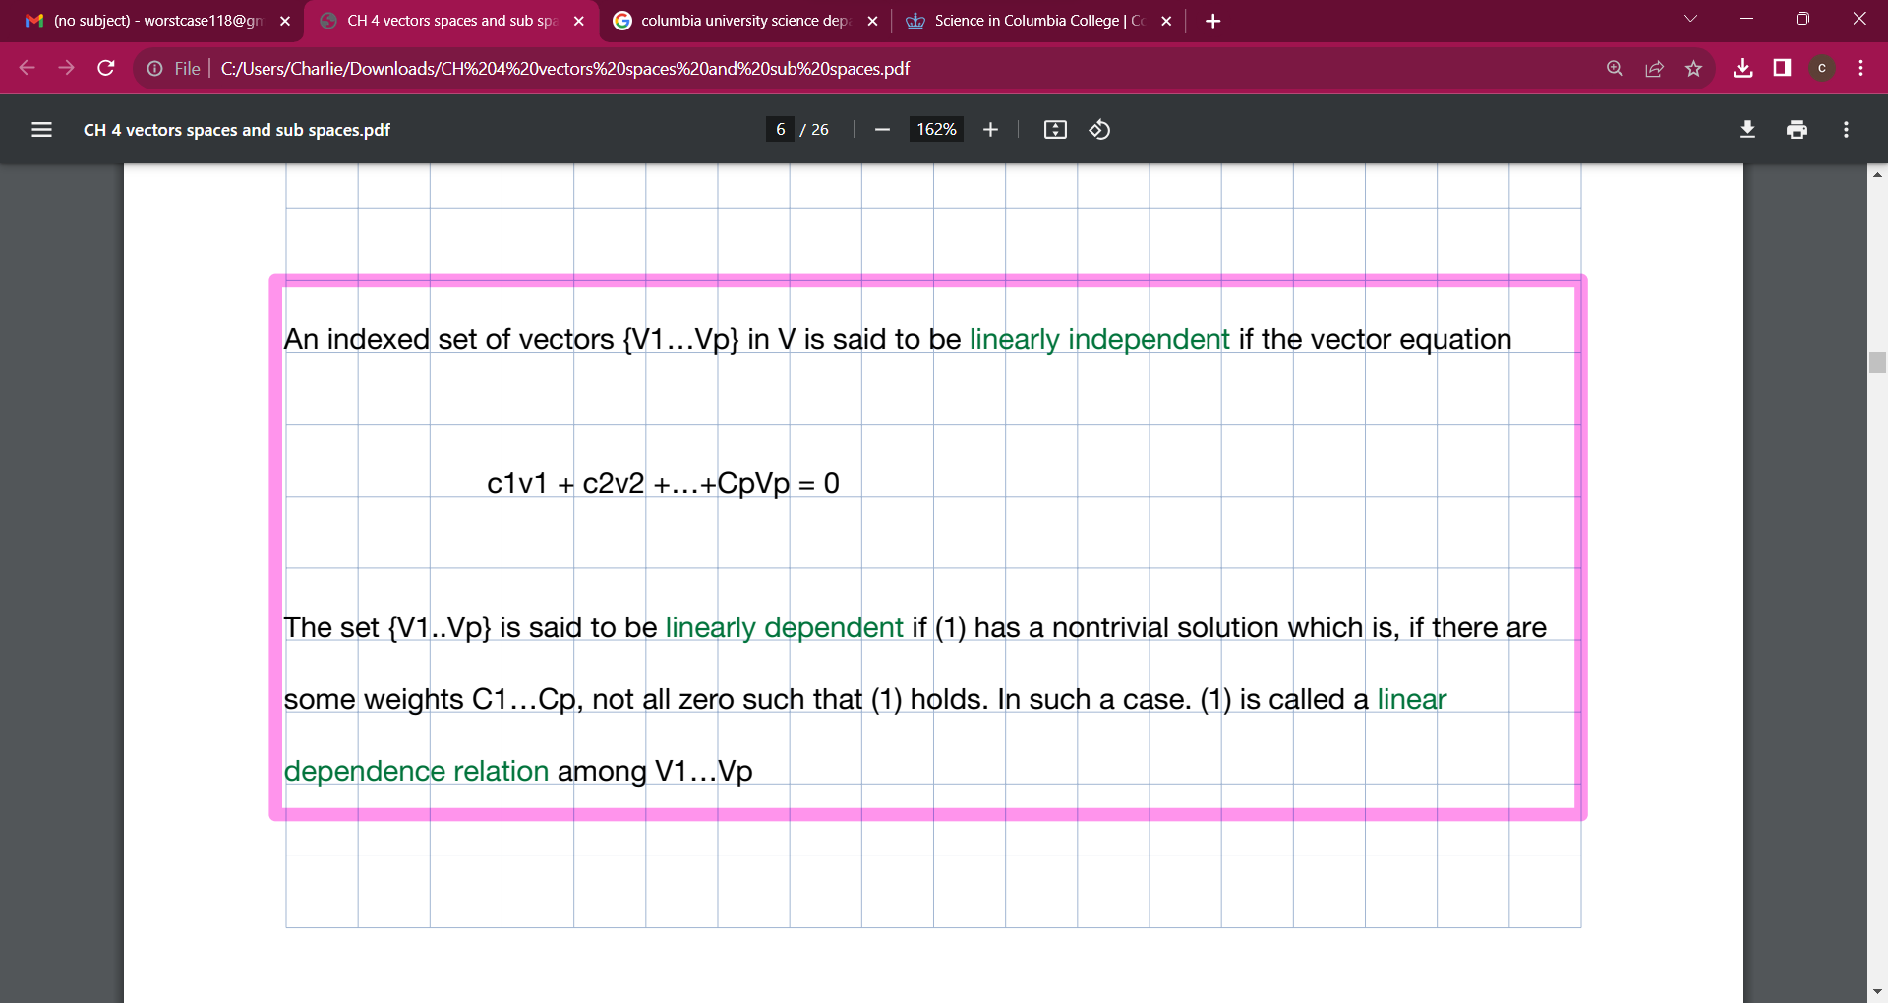

Slide 18
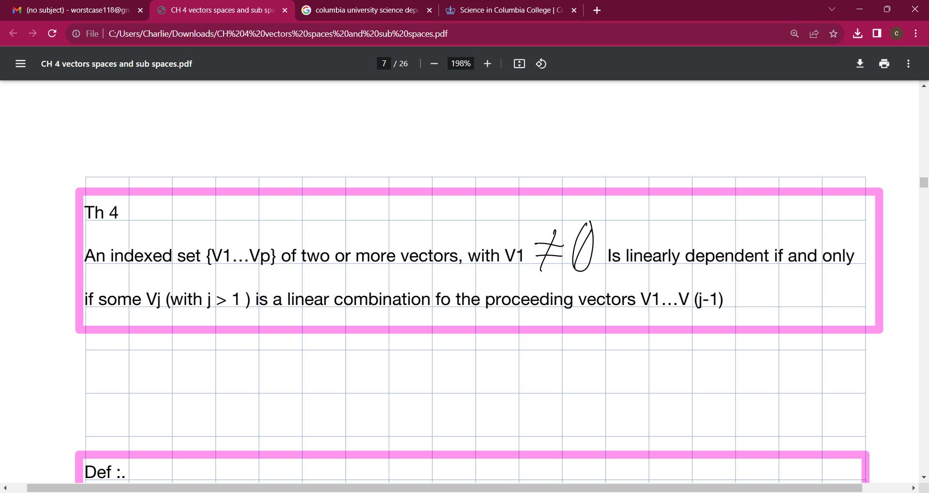

Slide 19
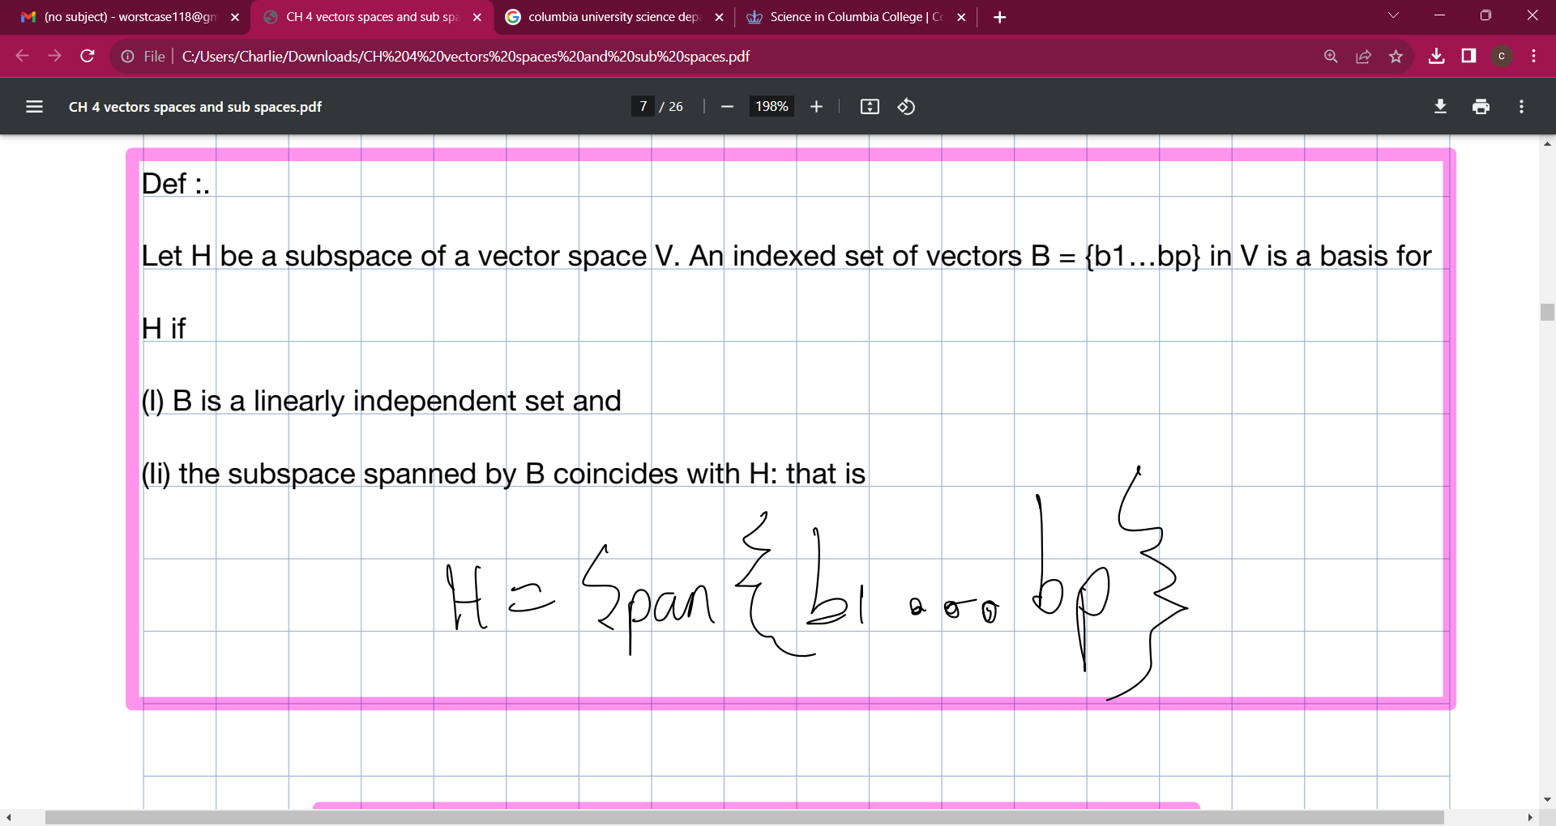

Slide 20
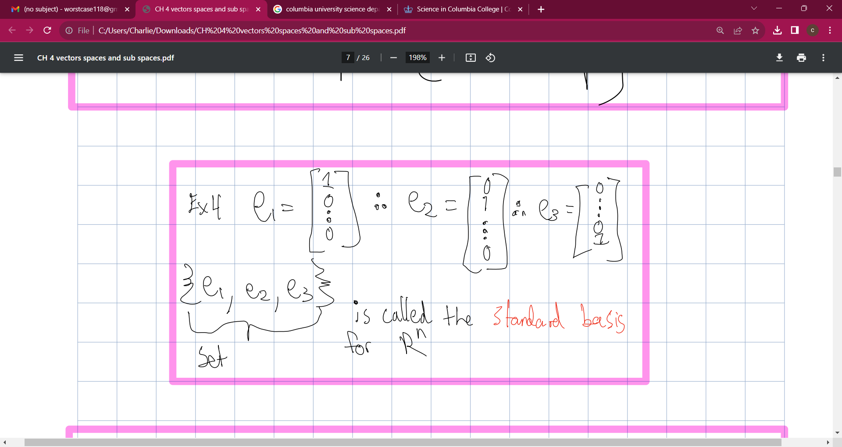

Slide 21


Slide 22
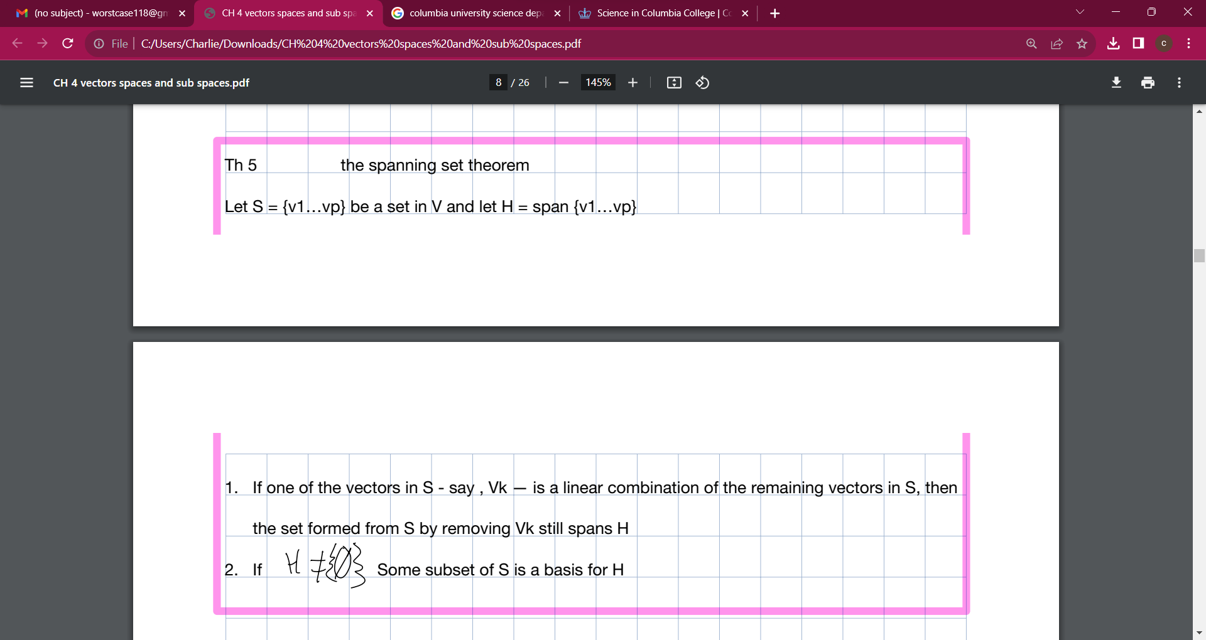

Slide 23
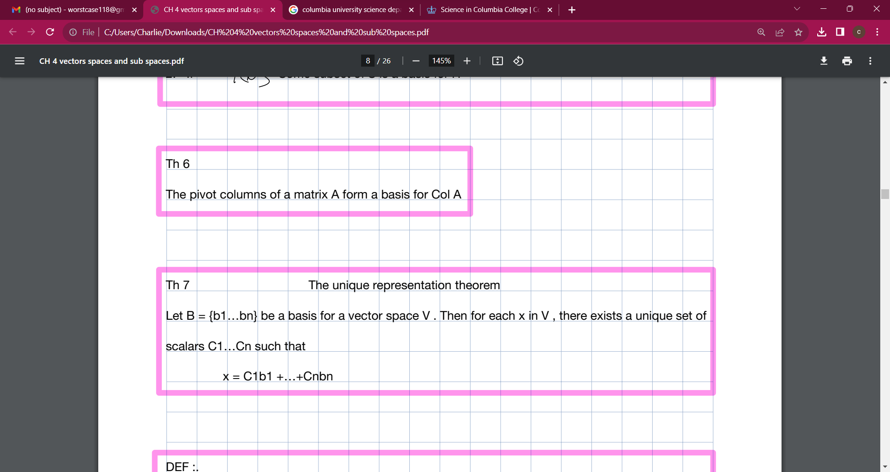

Slide 24
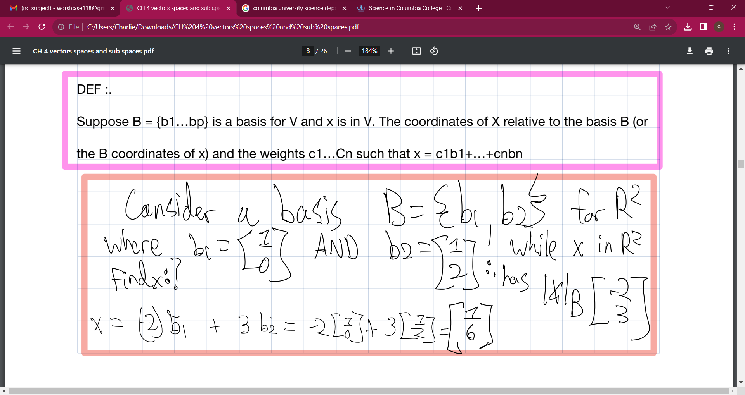

Slide 25
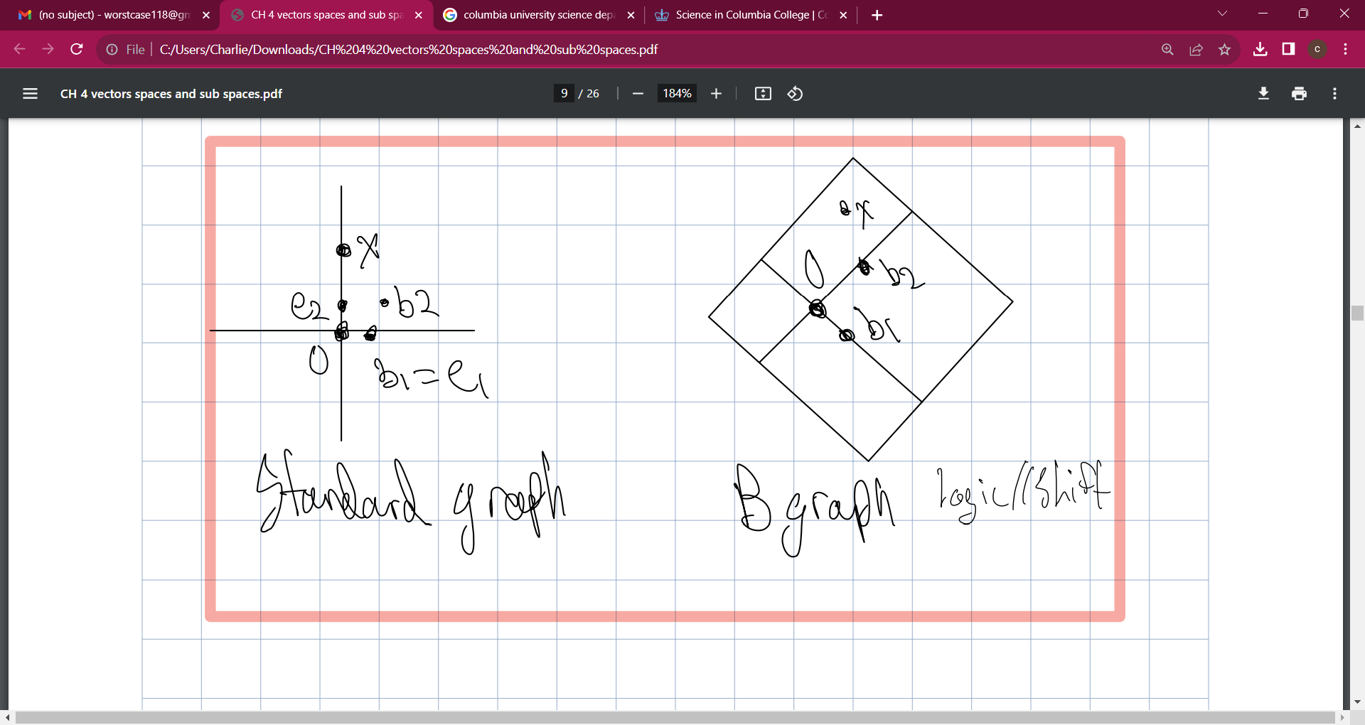

Slide 26
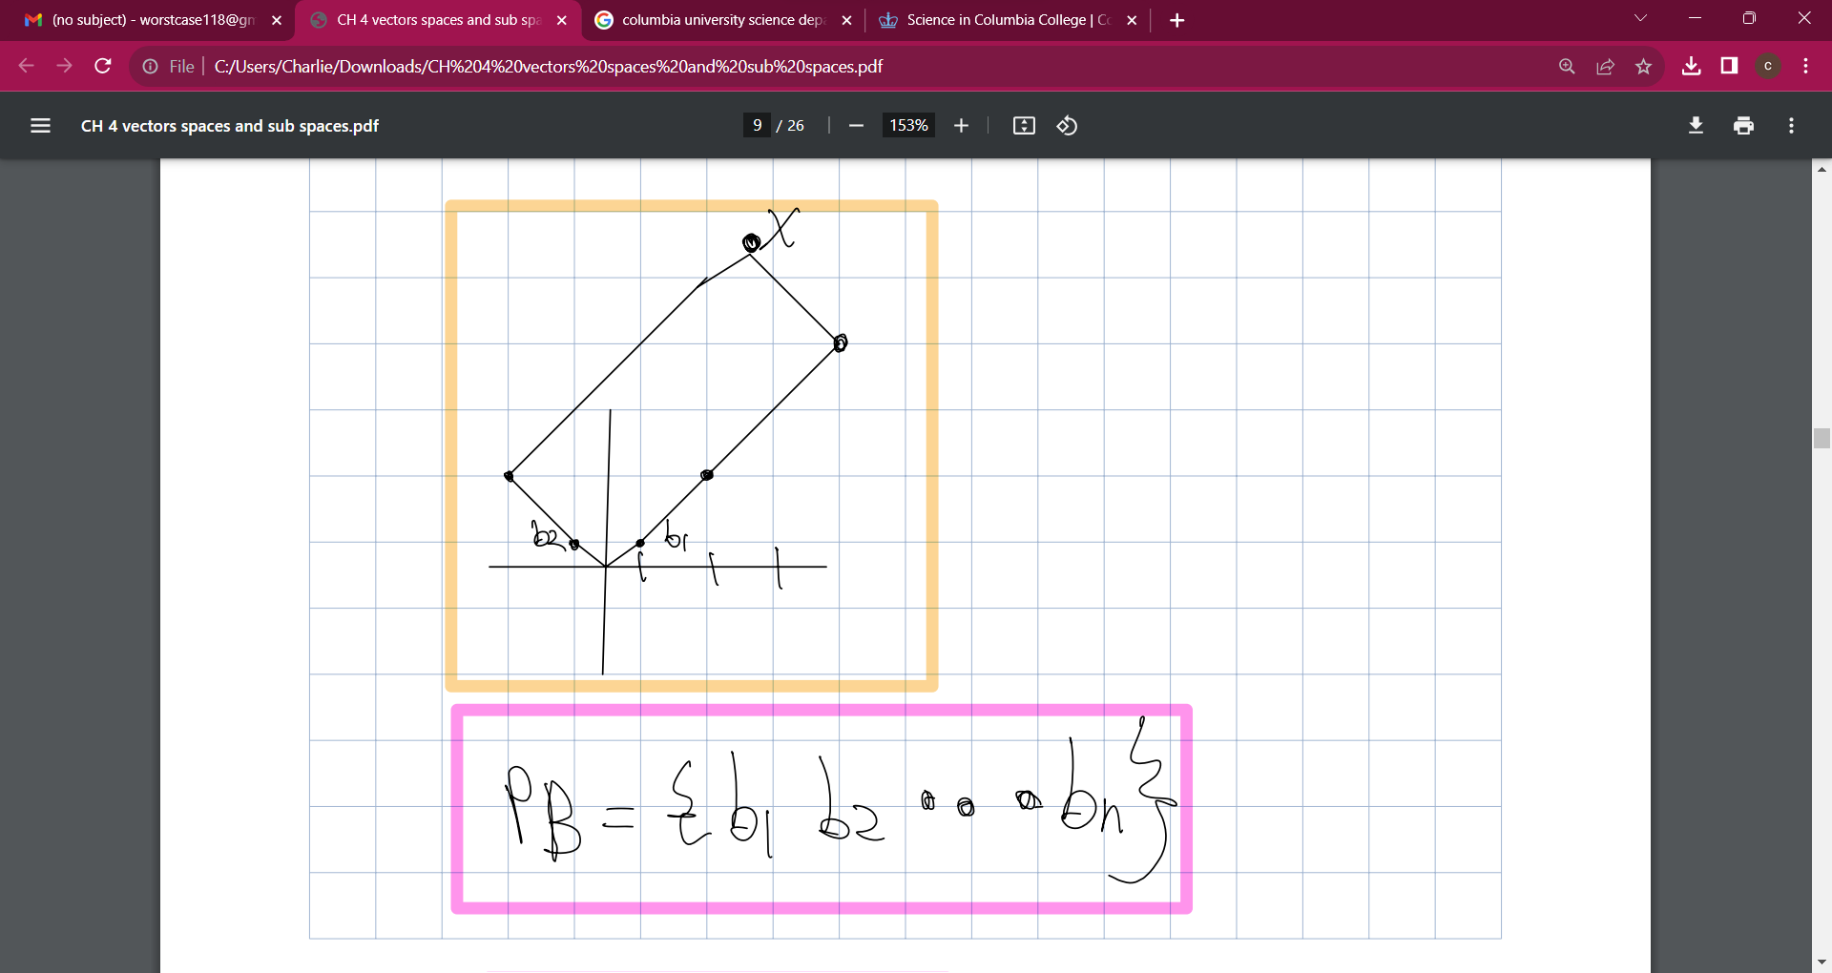

Slide 27
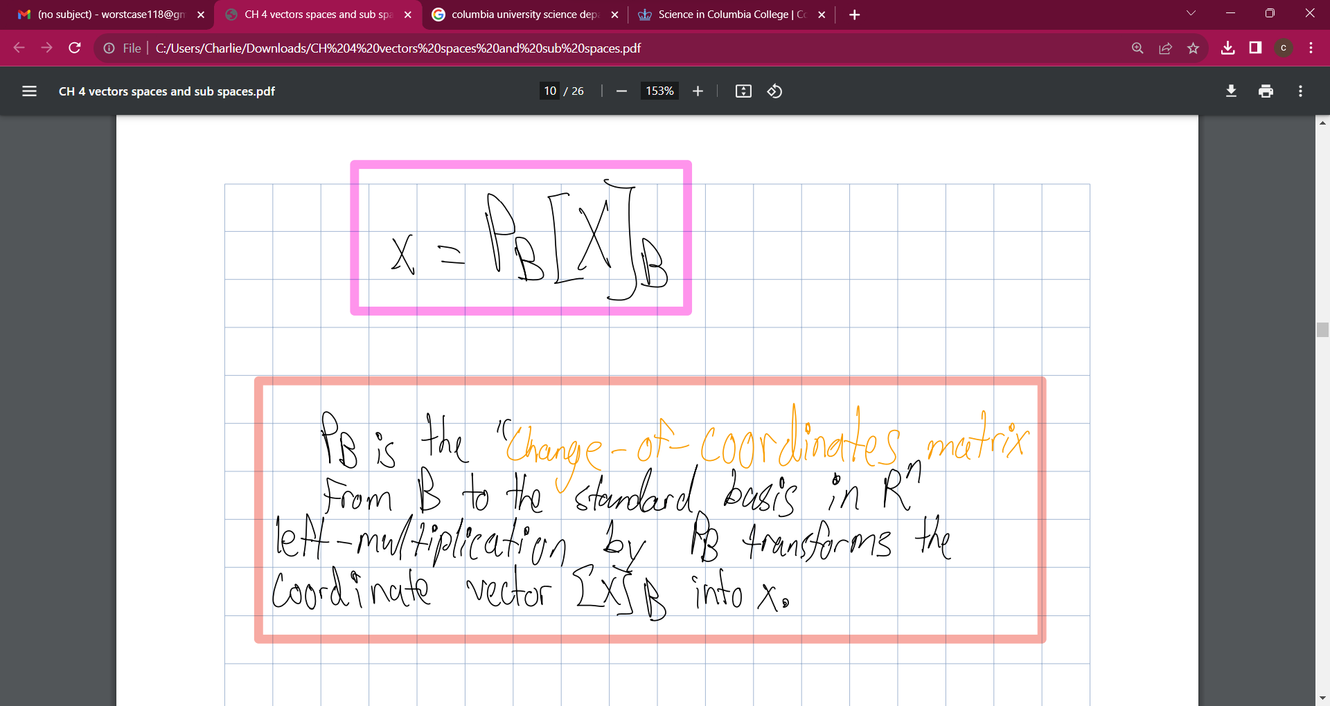

Slide 28
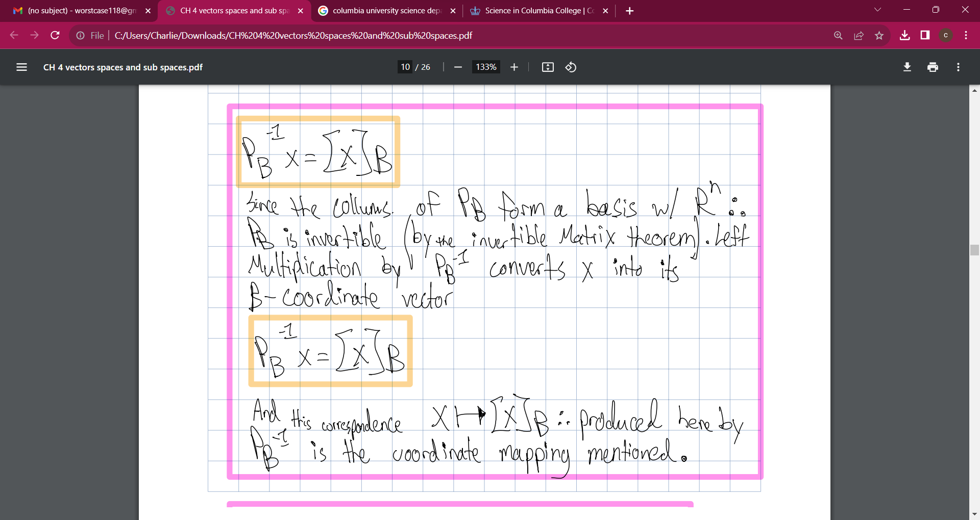

Slide 29
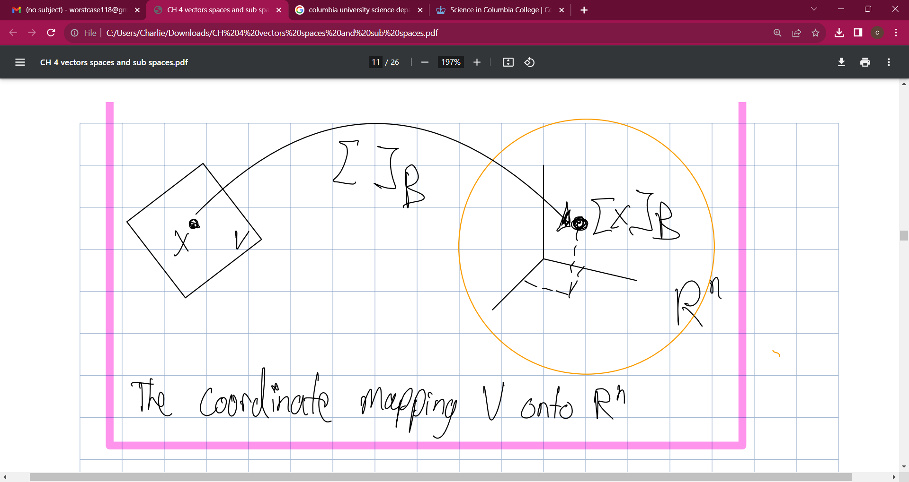

Slide 30
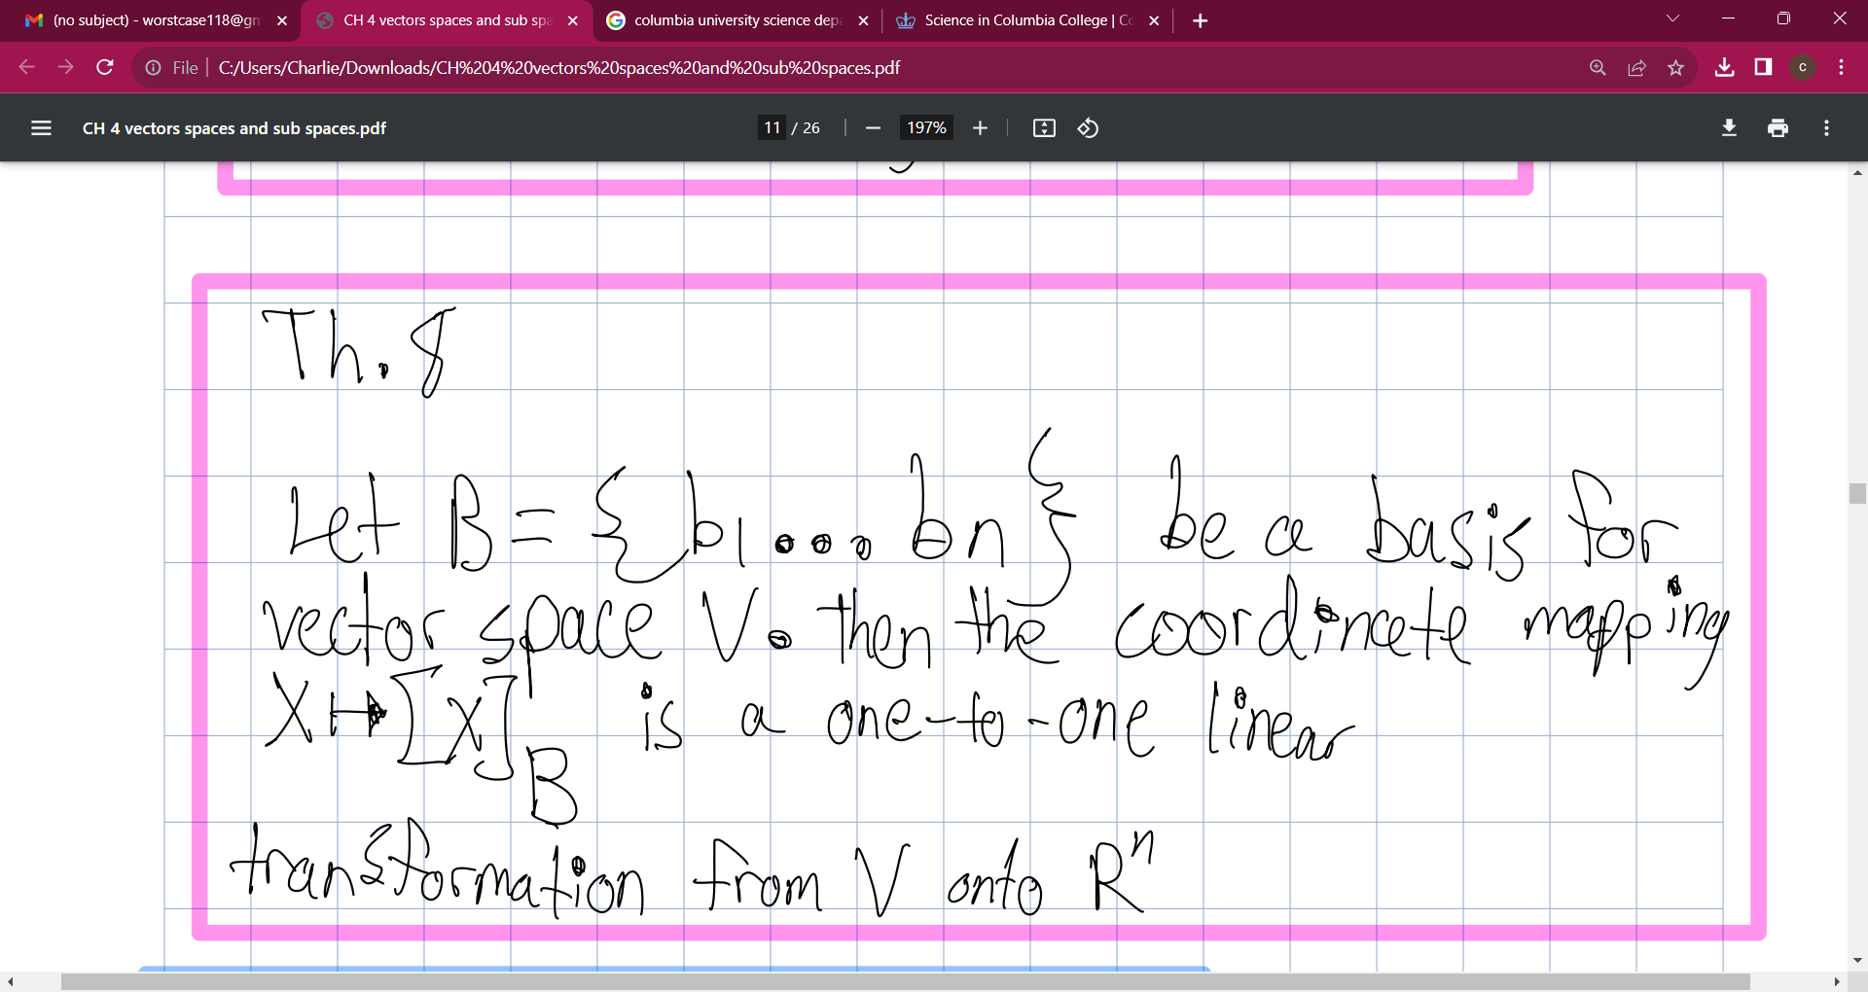

Slide 31
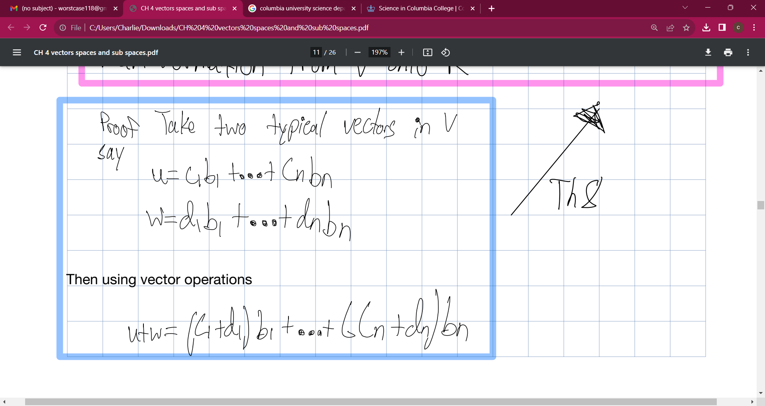

Slide 32



Slide 33
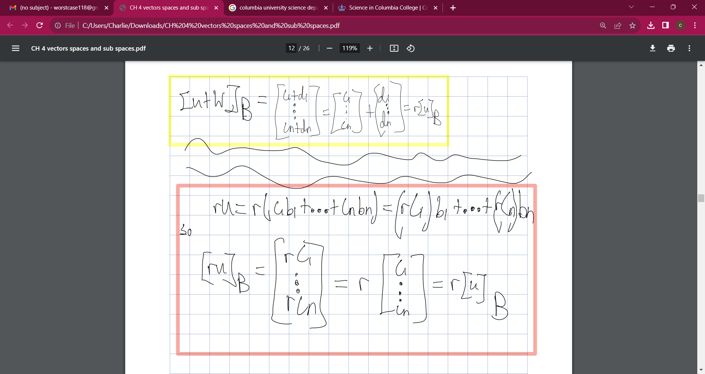

Slide 34
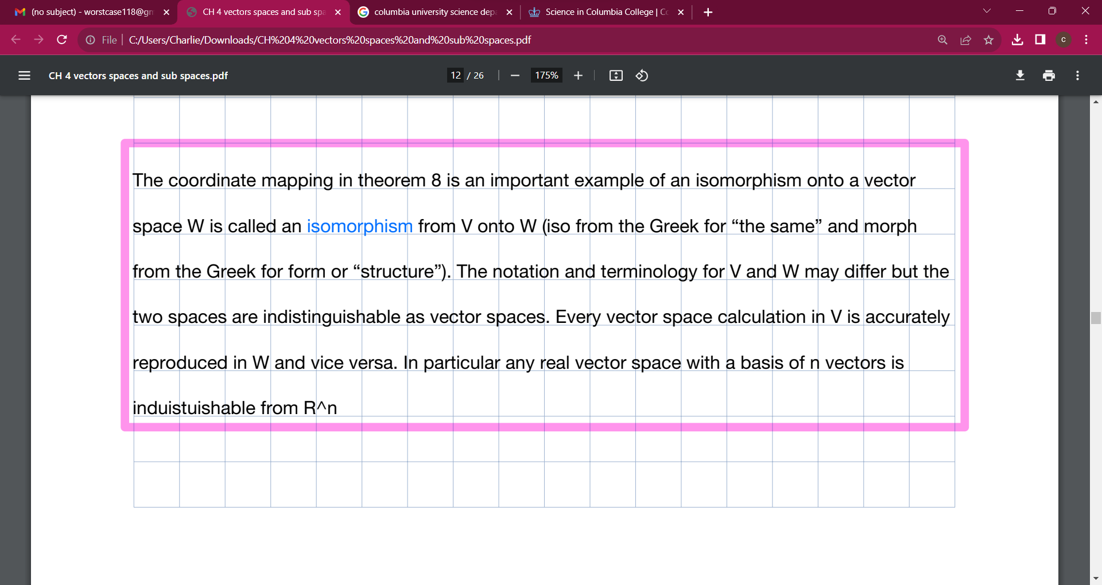

Slide 35
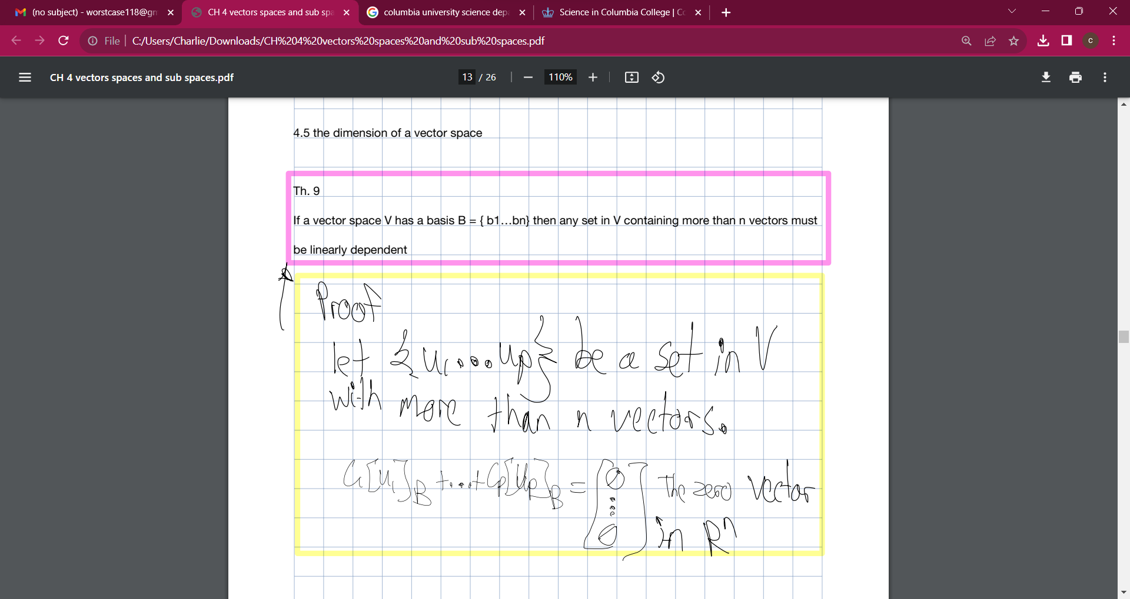

Slide 36
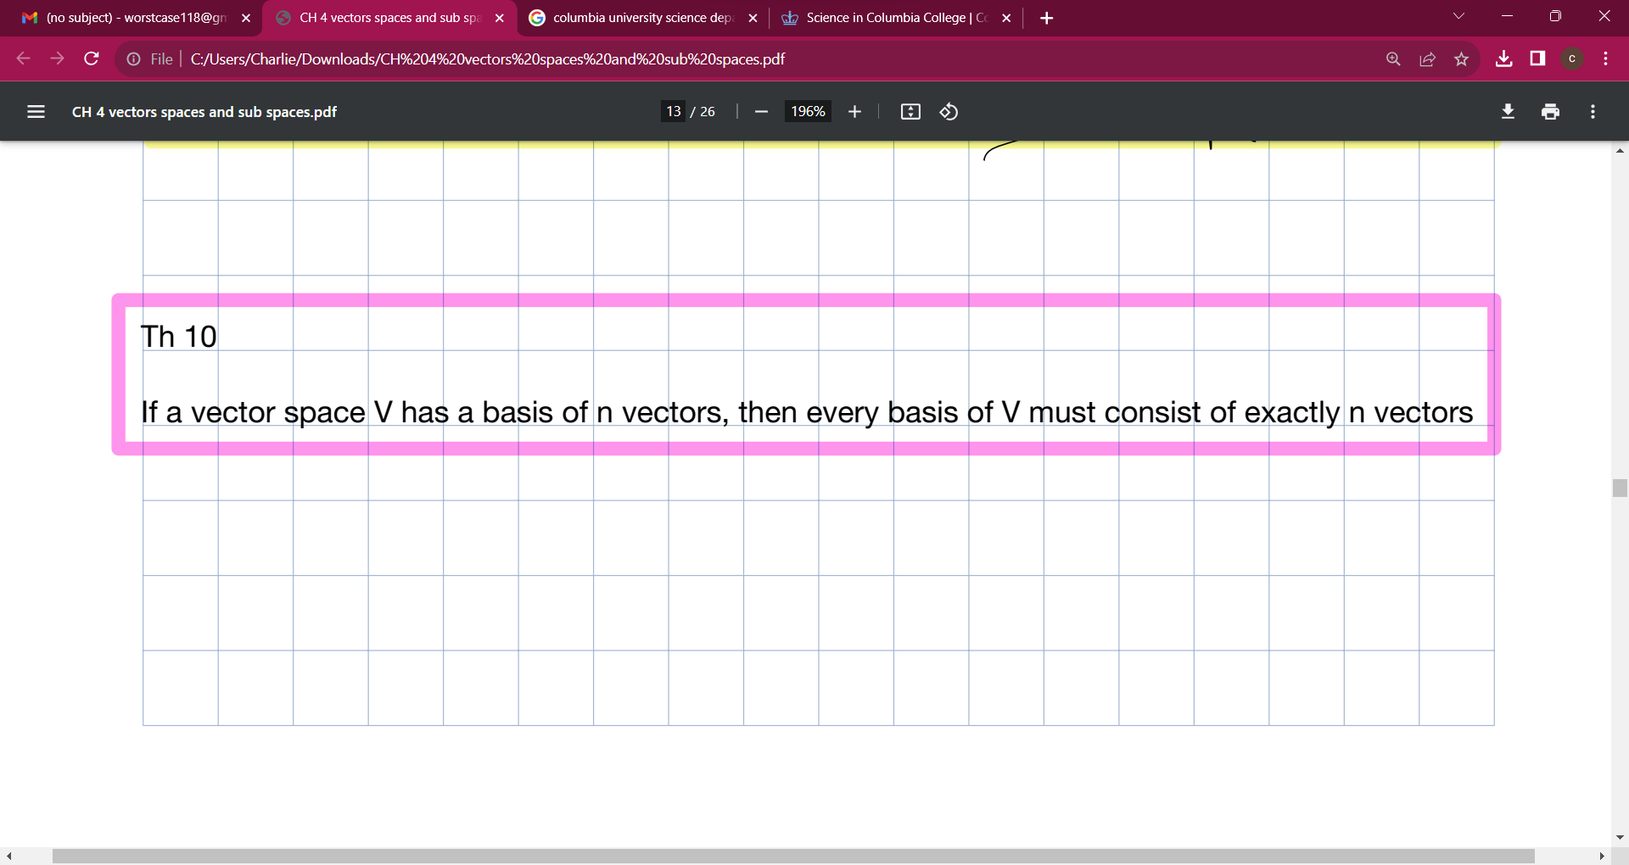

Slide 37
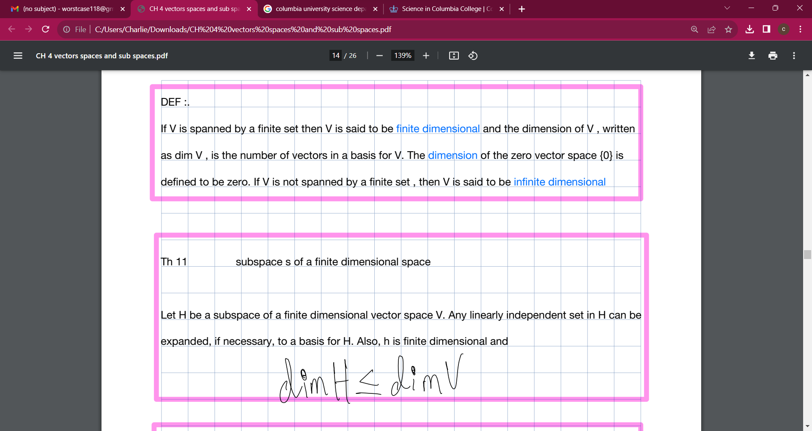

Slide 38
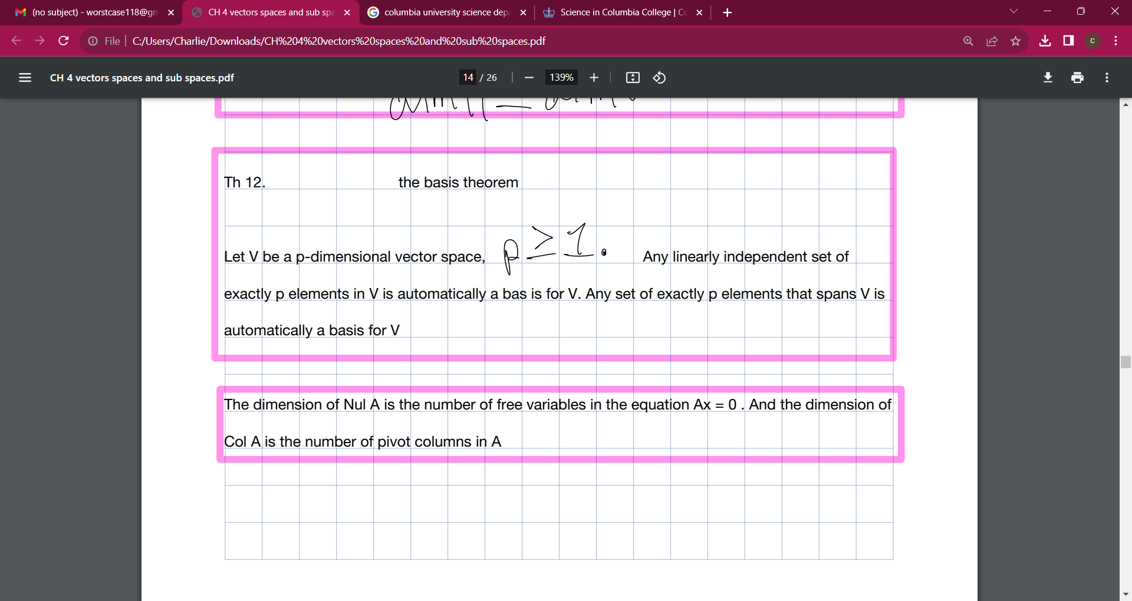

Slide 39
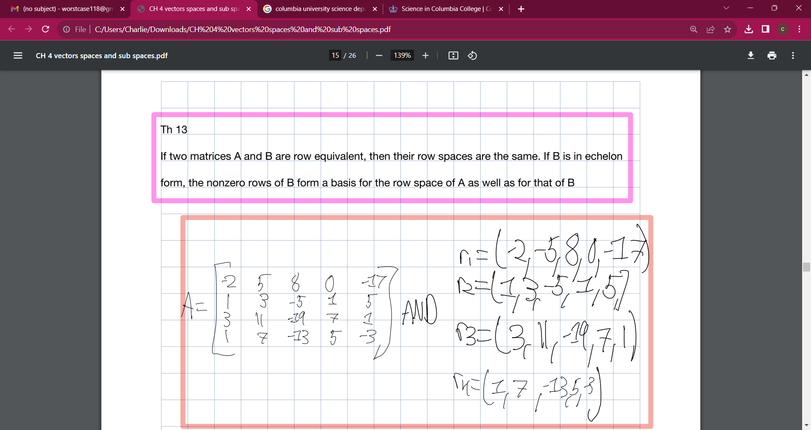

Slide 40
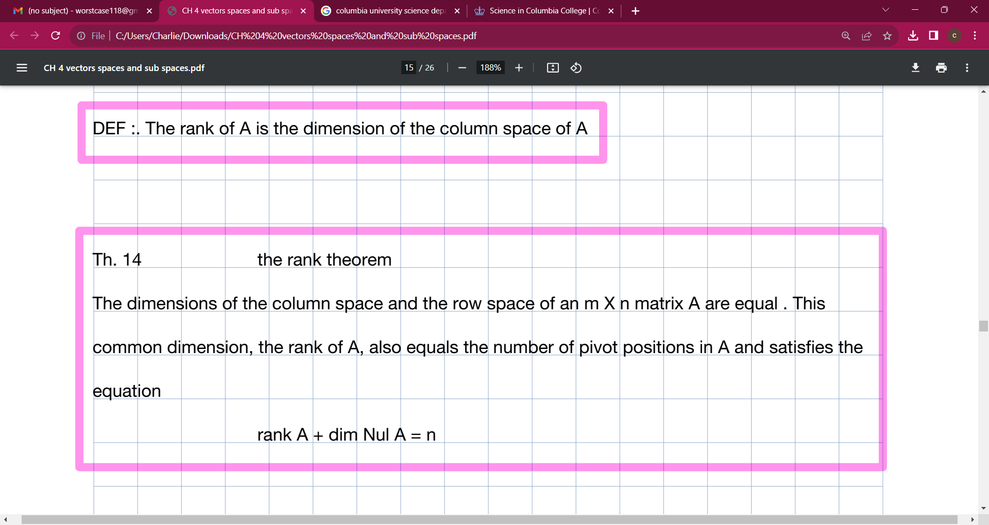

Slide 41
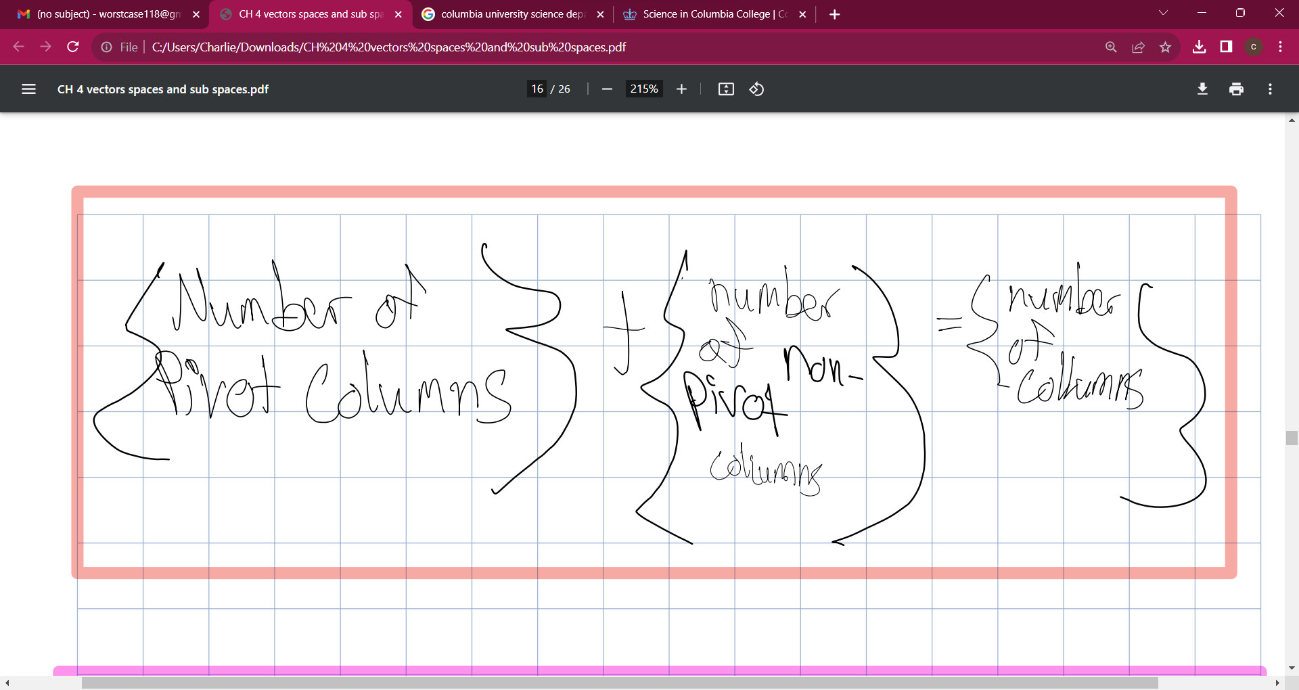

Slide 42
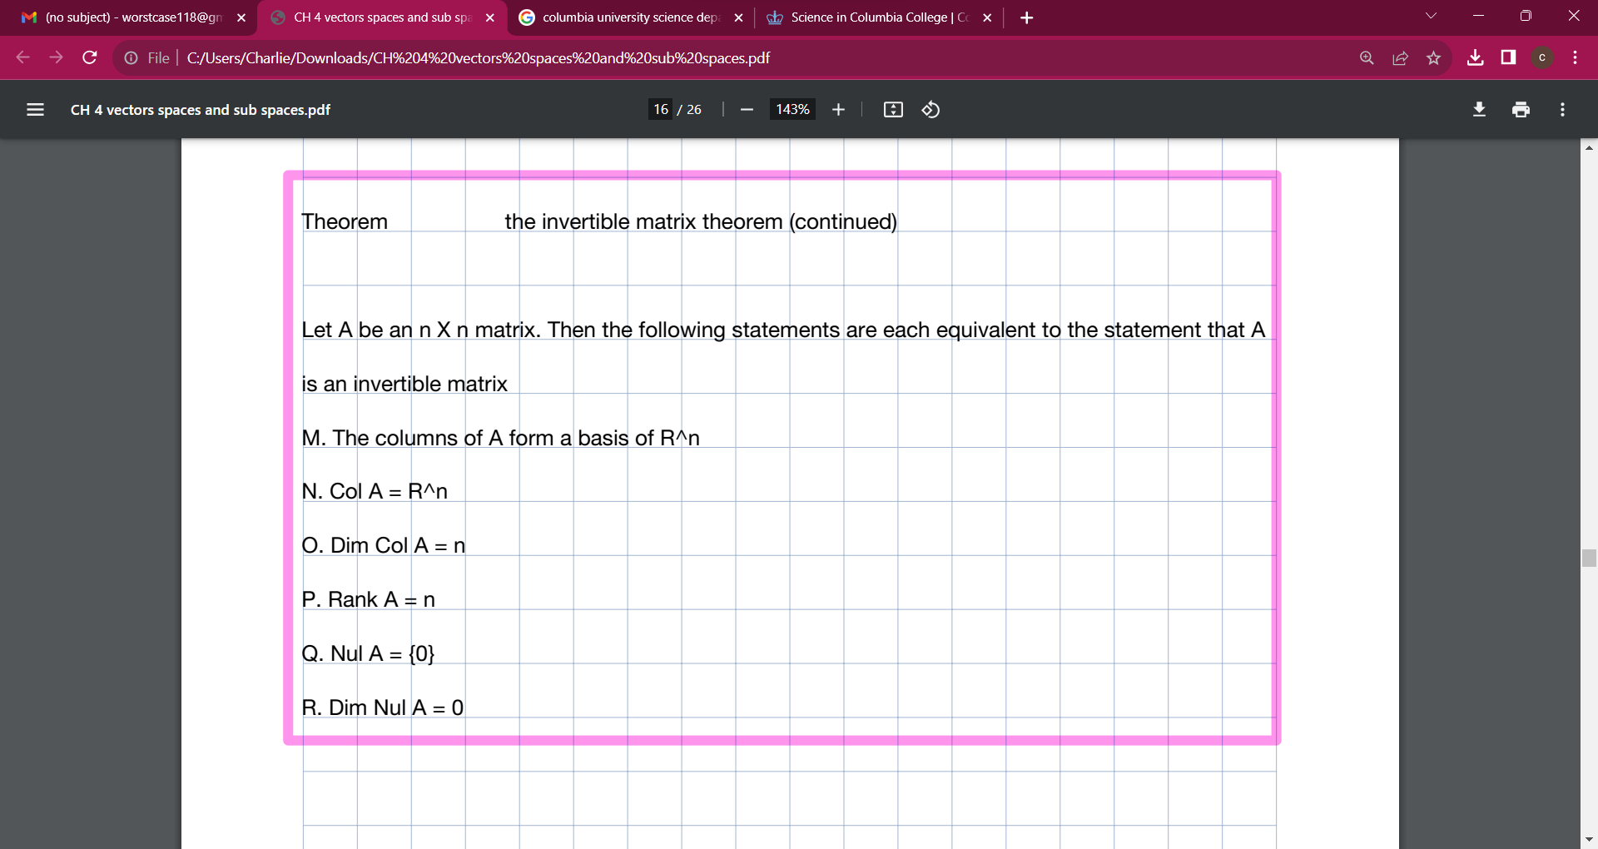

Slide 43



Slide 44
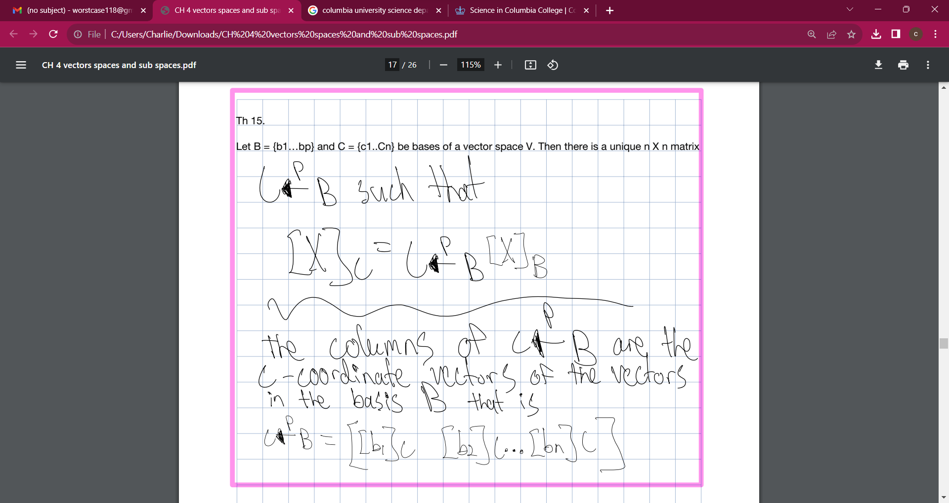

Slide 45
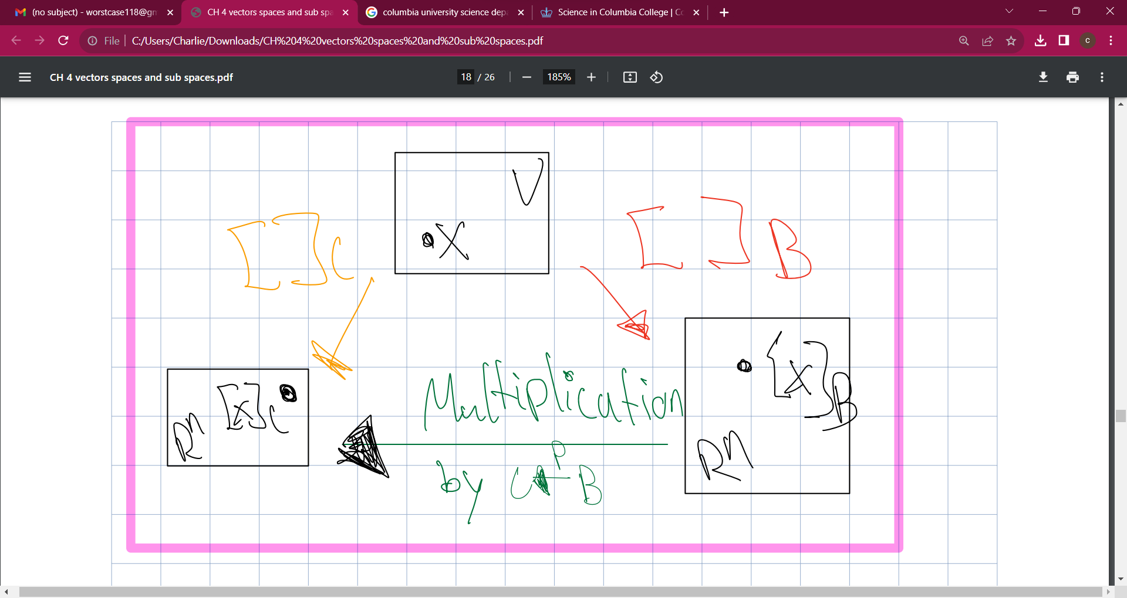

Slide 46
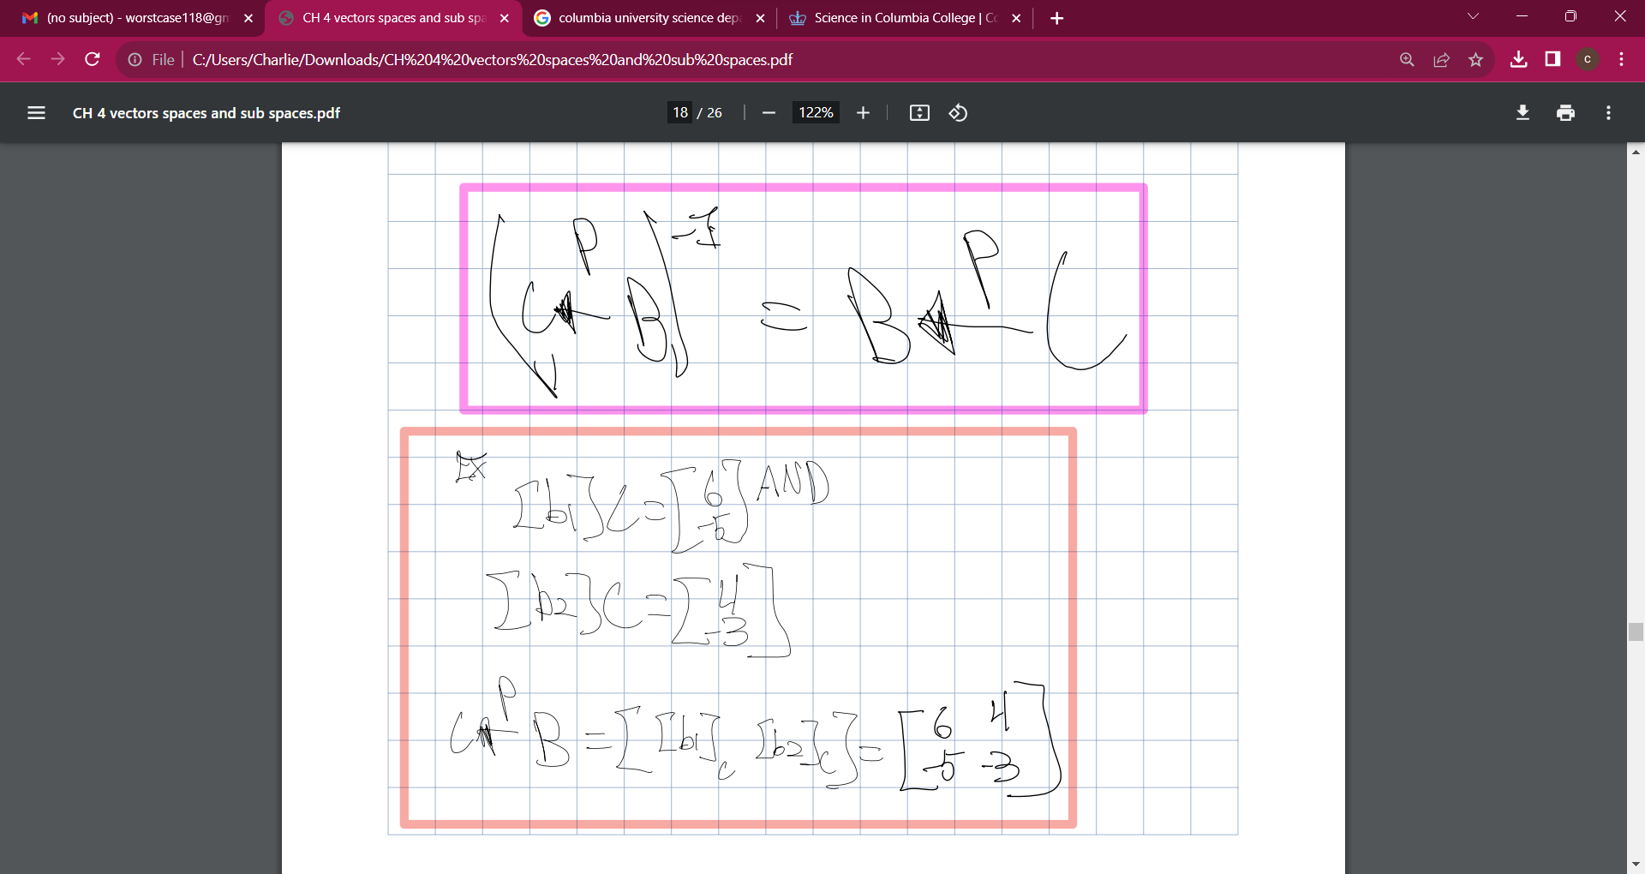

Slide 47
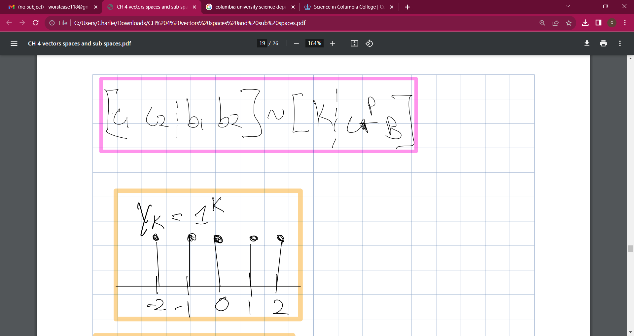

Slide 48
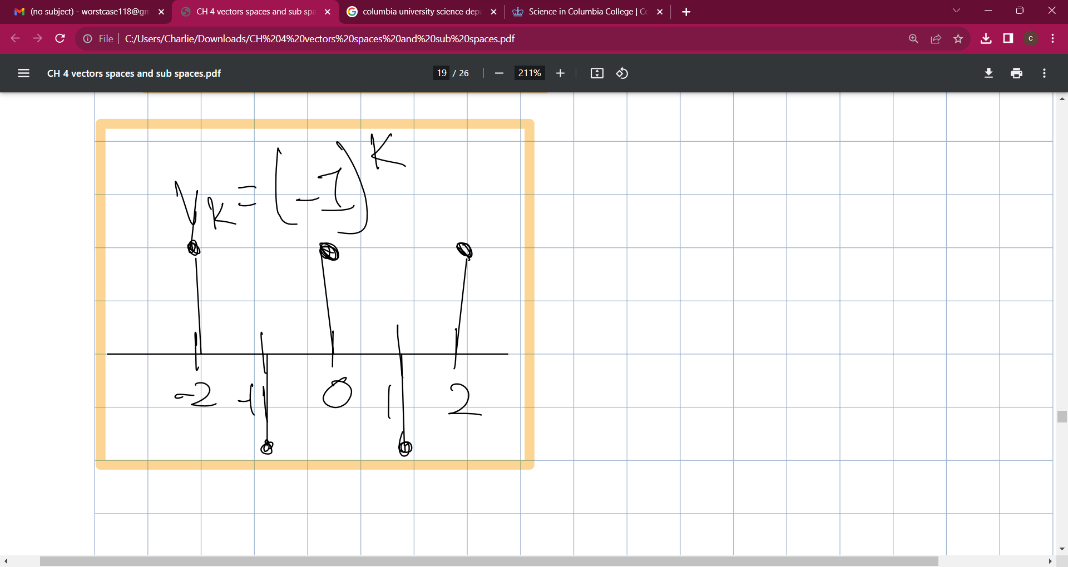

Slide 49
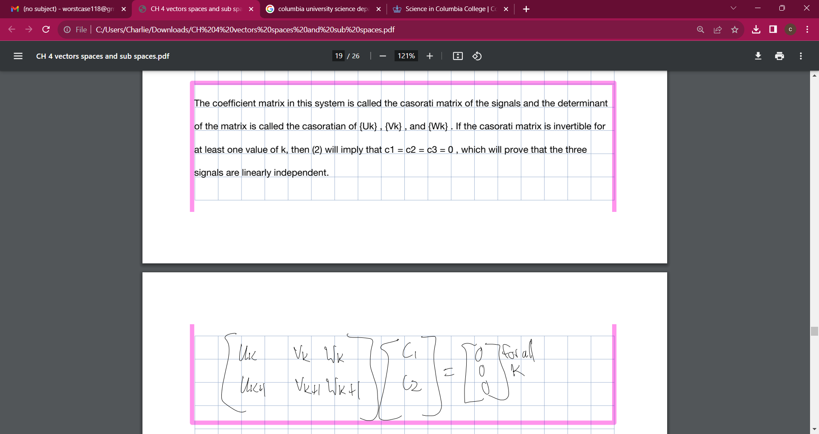

Slide 50
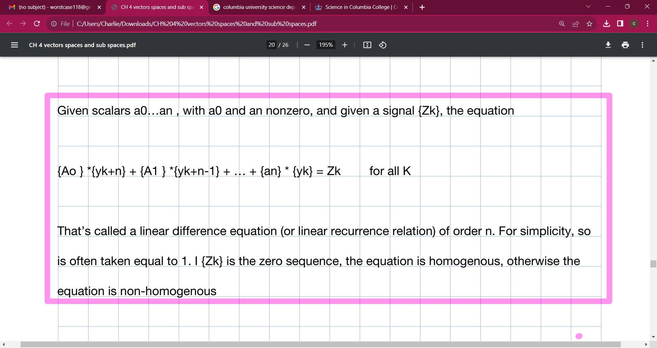

Slide 51
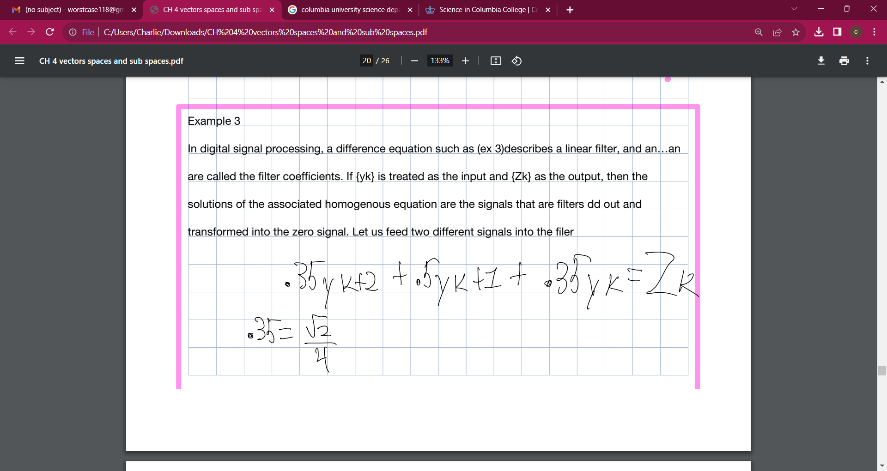

Slide 52
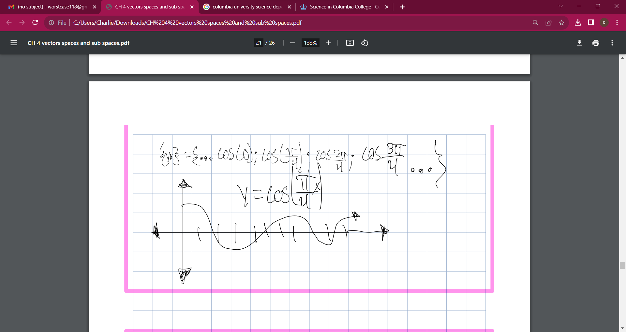

Slide 53
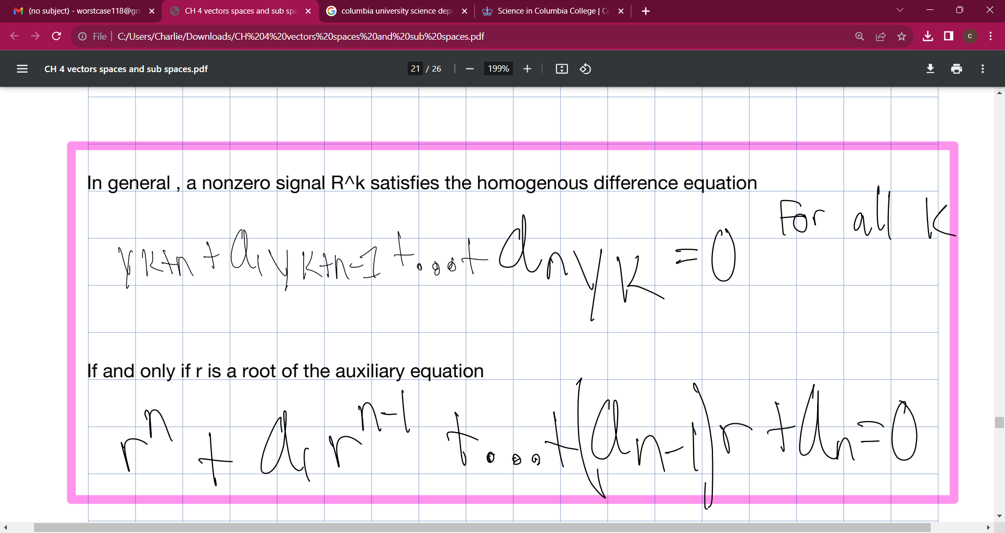

Slide 54



Slide 55
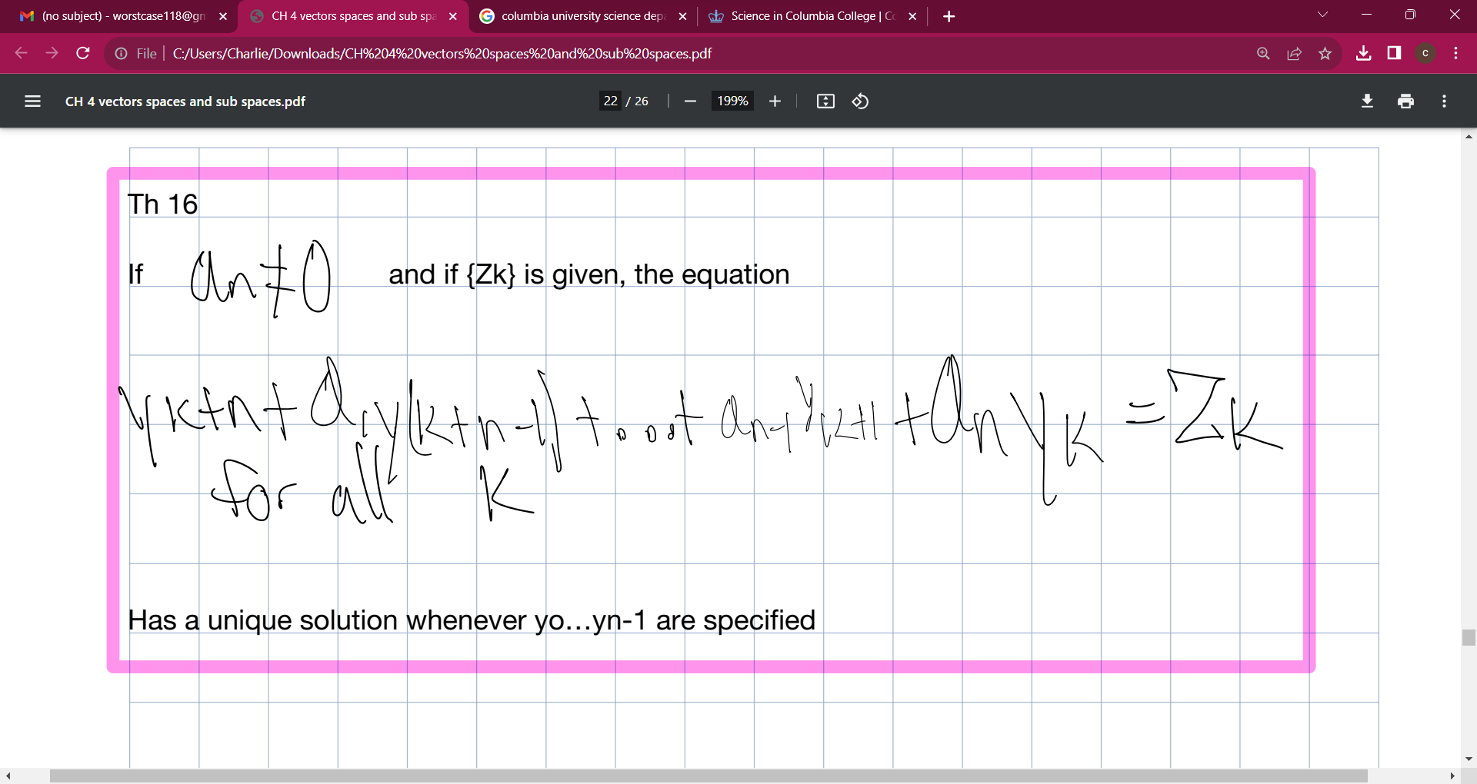

Slide 56
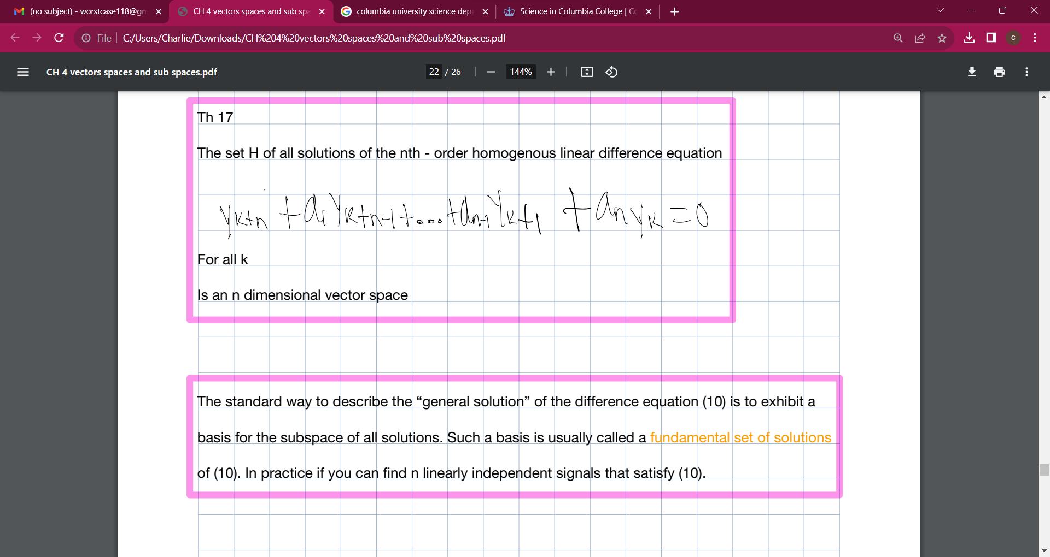

Slide 57


Slide 58


Slide 59


Slide 60


Slide 61


Slide 62


Slide 63


Slide 64


Slide 65




